Slide 1
The pragmatics of (non-) exhaustivity in wh-questions
Morgan Moyer Rutgers/Stanford
ALPS lab meeting September 22, 2020
Notes:
Thank you everyone for coming, it’s great to have everyone every
really glad you could make it,
Hi to my family,
it’s an honor to have these researchers gathered here to talk about my work
im very grateful

Slide 2
Where can I find coffee?
Dana knows where we can find coffee.
Dana knows one can find coffee at Peet’s, Starbucks, and
Hidden Grounds (and not at B&N)
Dana knows one can find coffee at Peet’s (or Starbucks or Hidden Grounds).
Mention-All,
Exhaustive
(MA)
Peet’s,
Starbucks,
Hidden Grounds,
¬Barnes & Noble
Mention-Some,
Non-Exhaustive
(MS)
Hamblin 1973; Hintikka 1976; Karttunen 1977; Groenendijk & Stokhof 1982/84
Notes:
These questions are inherently ambiguous

Slide 3
Who came to the party?
Dana knows who came to the party
Dana knows, for all the relevant people, whether they came to the party
Dana knows, for at least one person, that they person came to the party.
Mention-All,
Exhaustive
(MA)
Mention-Some,
Non-Exhaustive
(MS)
Hamblin 1973; Hintikka 1976; Karttunen 1977; Groenendijk & Stokhof 1982/84
Notes:
Who came to the party and its embedded counterpart are classic examples of questions where MS is purportedly not allowed. It seems that many, if not most questions have a baseline exhaustive interpretation

Slide 4
Today’s talk
A tale of two theories | Form vs. Goal
Generalizing MS | Considering more questions
Whither exhaustivity? | (Non-)exhaustivity and the speaker-hearer dynamic
Hearer preferences | Diagnosing (non-) exhaustivity resolution
Whither semantics? | Underlying grammar
Notes:
B: none of these factors are categorial in the determination of sentence meaning
We’re going to see that there’s a lot of VARIATION, and disagreement. So this is a place where we

Slide 5
A. A tale of two theories
Linguistic constraints (wh-word, matrix verb, Modal)
Contextual licensing
The Form vs. The Goal Hypothesis

Slide 6
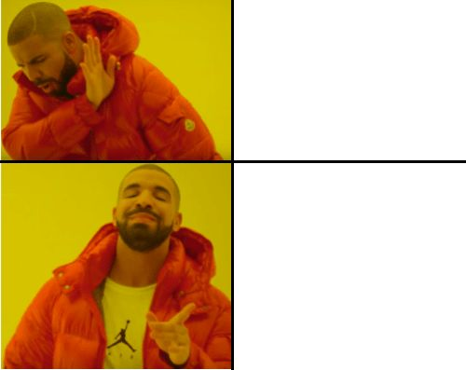
Form constraints
MS?
Dana knows who came to the party.
Dana knows where to find coffee.
Matrix Verbs: weak vs. strong MA
Karttunen 1977; Groenendijk & Stokhof 1982, 1984; Berman 1991; Heim 1994; Ginzburg 1995; Lahiri 2002; Spector 2005; Guerzoni & Sharvit 2007; Egré 2008; Zimmermann 2010; Klinedinst & Rothschild 2011; George 2011; Theiler 2014; Romero 2015; Spector & Egré 2015; Uegaki 2015; Theiler, Roelofson, & Aloni 2019; Mayr 2019; Uegaki & Sudo 2019, a.o.
Wh-Word
Hintikka 1976; Ginzburg 1995; Asher & Lascarides 1998
◇ Modal & -FIN
George 2011, Ch6; Nicolae 2014; Fox 2014; Dayal 2016; Xiang 2016, 2020; Bhatt 1999 for -FIN

Slide 7
Observation 1 | Wh-word.
#MS MA
Who came to the party?
Which students came to the party?
Where can I find an Italian newspaper?
How do I get to the buried treasure?
Why did the Roman Empire fall?
MS ?MA
Ginzburg 1995; Asher & Lascarides 1998

Slide 8
What is the wh-word contributing?
No real distinction in the lexical semantics
Except referential domains
Plural-marked which Ns (Comorovski 1996)? Easy to override with context (cf. Dayal 2016)
(Pragmatic) effects of resolving wh-domain:
Granularity effects (Ginzburg 1995)
De re/de dicto effects (Boër & Lycan 1975, 1985; Groenendijk & Stokhof 1982/1984)
Aloni (2002, 2005): conceptual covers
Notes:
this could maybe be construed as another manipulation of contextual goals, which also probably govern granularity
So while this may not apparently translate to a difference between MS and MA, we will should keep it in the back of our minds and something that does differ between them.

Slide 9
Observation 2 | Matrix Verbs.
Dana knows who came to the party.
Mary predicted where to find coffee.
Mary was surprised by where we found coffee.
?MS
MA
MS
MA
Heim 1994, Zimmermann 2010; George 2011
Notes:
A long time observation is that interrogative embedding verbs often impose restrictions on the semantics of their complements. WRT exhaustivity, the observation has been that 'know-wh' seems to require Strong exhaustive interpretations of its interrogative complement, while other verbs like emotive factives or non-factives require weak exhaustive interpretations of their embedded complements.

Slide 10
Verb constraints on exhaustivity?
Long debate about verbs and strengths of exhaustivity (Karttunen 1977; Groenendijk & Stokhof 1982, 1984; Berman 1991; Heim 1994; Ginzburg 1995; Lahiri 2002; Spector 2005; Guerzoni & Sharvit 2007; Egré 2008; Klinedinst & Rothschild 2011; George 2011; Theiler 2014; Romero 2015; Spector & Egré 2015; Uegaki 2015; Theiler, Roelofson, & Aloni 2019; Mayr 2019; Uegaki & Sudo 2019, a.o.)
George (2011, Ch. 2): Verbs can select for EXH (MA), or not (MS)—know selects for EXH. (also Heim 1994; Zimmermann 2010)
But why?: Dana knows where we can find coffee.
Dana knows how to get to Central Park.
Notes:
On George's semantics from their dissertation, there's either a SE semantics (where the interrogative LF contains an exhaustivity operator), or theirs a non-exhaustive/MS semantics (where the LF does NOT contain the EXH operator).
George suggests that know *selects* for the EXH operator. Even if that's right, we might wonder how robust this restriction is, since we can easily get MS with know-how and know-where questions.

Slide 11
Observation 3 | (◇) Modals.
MS
MA
Where can I find a coffee?
Dana knows where I can find a coffee.
Dana knows where to find a coffee.
Which numbers under 10 are prime?
Dana knows which numbers under 10 are prime.
What gas stations are open now?
Dana knows what gas stations are open now.
Who came to the party?
Dana knows who came to the party.
#MS
MA
Notes:
The observation that has most compelled the attention of formal semanticists is that modal questions seem to be the ones that permit Mention-some readings. CLICK
TRANSITION: However, the modal theory runs into problems because there seems to be data that it cannot account for – NEXT SLIDE

Slide 12
Form/◇ Modal Theory
Modal/-FIN questions grammatically license MS via scope ambiguity. (George 2011; Fox 2014; Nicolae 2014; Xiang 2016; Bhatt 1999 for -fin)
Overt or covert existential priority modal:
…where to find coffee ≈ where we can find coffee (Bhatt 1999)
Notes:
There are two primary theories as to why a question might want a non-exhaustive answer. CLICK
The Modal Theory posits that the presence of a modal (or a covert modal in a non-finite embedded clause) is what permits a non-exhaustive answer. CLICK
The pragmatic theory posits that non-exhaustivity will be permitted when a non-exhaustive answer satisfies contextual discourse goals.
Now, here, we're grouping together several theories that aren't formally identical, but the main unifying factor is the importance of some feature of the context.
There’s also ambiguity theories, which hold that all questions are ambiguous between the two readings. As yimei mentioned, these will ultimately reduce to pragmatic theories because ”pragmatics” will determine the reading.
but we will put these aside for the purposes of this presentation.

Slide 13
MS without modals
How do I get to the buried treasure?
Dana knows how we get to Central Park.
(Hintikka 1976; Asher & Lascarides 1998)
What’s a typical Russian name?
(Roelofsen, Ciardelli, Aloni)
Who’s going to the party? (Dayal, pc)
Who has a light? (Groenendijk & Stokhof 1982, 1984; van Rooij 2003)
Notes:
B: none of these factors are categorial in the determination of sentence meaning

Slide 14


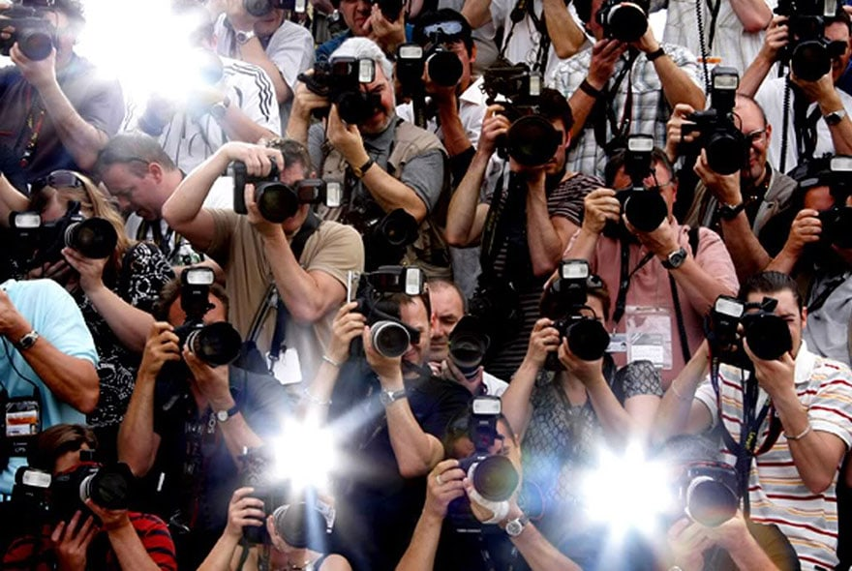


Observation 4 | Discourse goals Groenendijk & Stokhof 1982,1984; Ginzburg 1995; Asher & Lascarides 1998; van Rooij 2003, 2004
Where can I find coffee? Dana knows where to find coffee.
https://news.artnet.com/art-world/summer-tourist-art-disasters-310753
https://www.zikoko.com/money/10-ways-to-make-money-as-a-student-in-nigeria/attachment/black-woman-writing-758x506/
Who came to Elton John’s party? Dana knows who came to Elton John’s party.
https://up-magazine.info/en/technologies-a-la-pointe/lab/7529-facebook-veut-inventer-le-paparazzi-personnel/
https://www.threerivers.edu/2020/07/31/new-data-analytics-certificate-at-three-rivers-community-college/
Notes:
Another long-noted robust observation is that whether a Mention-some answer or interpretation is acceptable will be determined by some kind of non-exhaustive discourse goals.
The classic demonstration of this is "Where can I find an Italian newspaper?" but I like to use this example cause it lets me make a joke about aaron.
is the tourist vs. the entrepreneur.

Slide 15
Goal Theories
MS licensed by non-exhaustive contextual goals. (Groenendijk & Stokhof 1982, 1984; Ginzburg 1995; Asher & Lascarides 1998; Beck & Rullmann 1999; Lahiri 2002; van Rooij 2003, 2004; Schulz & van Rooij 2004; IS folks, Theiler et al 2019; Roelofsen & Dotlačil 2019)
All questions should allow MS when goals are MS, ceterus peribus…
MS will never be more informative than MA (Van Rooij 2003, 2004)
Notes:
The pragmatic theory posits that non-exhaustivity will be permitted when a non-exhaustive answer satisfies contextual discourse goals.
They take as their basic data point
Now, here, we're grouping together several theories that aren't formally identical, but the main unifying factor is the importance of some feature of the context.
There’s also ambiguity theories, which hold that all questions are ambiguous between the two readings. these will ultimately reduce to pragmatic theories because ”pragmatics” will determine the reading.
but we will put these aside for the purposes of this presentation.

Slide 16
B. Generalizing MS
Experiments 1 and 2 (Moyer & Syrett 2019, SuB, CLS)

Slide 17
Hypotheses
H1 | Modal (/non-finite) is necessary for MS. MS should be accepted only in the presence of modal/non-finite clauses, modulo pragmatics.
H2 | Modal (/non-finite) is not necessary for MS.
We should see acceptance across both clauses, modulo pragmatics.
Notes:
we can articualte two hypotheses: MS could only be available in modal clauses. so participants should reject nonmodals. On the other hand, we might
These hypotheses are getting at the question of whether the modal is necessary for MS?
Importantly were trying to abstract away from particular theories here

Slide 18
Stimuli | -FIN where
Billy and his neighbors are playing hide and seek in the park. It is his turn to close his eyes and count to ten.
Actually, his friends are hidden under the slide, in the tunnel, and behind the swings, but not in the tree.
After he is finished counting, he sees his classmate Jimmy, and asks Jimmy to help him find his friends.
Notes:
Here's an example stimulus for a nonfinite clause

Slide 19
Test
MS
Answer
Jimmy says, “Under the slide.”
Billy reports, “Jimmy knows where to find the people hiding.”
Is Billy right?
Yes No
Verb
WH
-FIN

Slide 20
Experiment 1 | Form Factors Only n=232 (14 excluded for non-native speaker status )
MA
MS
Mixed T+F
False
Acceptability judgement task
Qualtrics software (Provo, UT)
Run in-lab
Within subjects
Answer
Matrix verb
Wh-word
Between subjects: finiteness
All factors fully crossed (32 lists)
know
predict
who
where
-FIN
+FIN
Notes:
So Experiment 1 fully crossed each factor. So within subjects we

Slide 21
Experiment 1 | Form Factors Only n=232 (14 excluded for non-native speaker status )
8 different embedded verbs for each wh-word.
…How generalizable is MS?
Acceptability judgement task
Qualtrics software (Provo, UT)
Run in-lab
Within subjects
Answer
Matrix verb
Wh-word
Between subjects: finiteness
All factors fully crossed (32 lists)
Minimal changes to embedded predicate:
where to find….
where they found…
Minimal changes to context
to satisfy the felicity conditions
of finite and non-finite clauses
Notes:
So Experiment 1 fully crossed each factor. So within subjects we

Slide 22
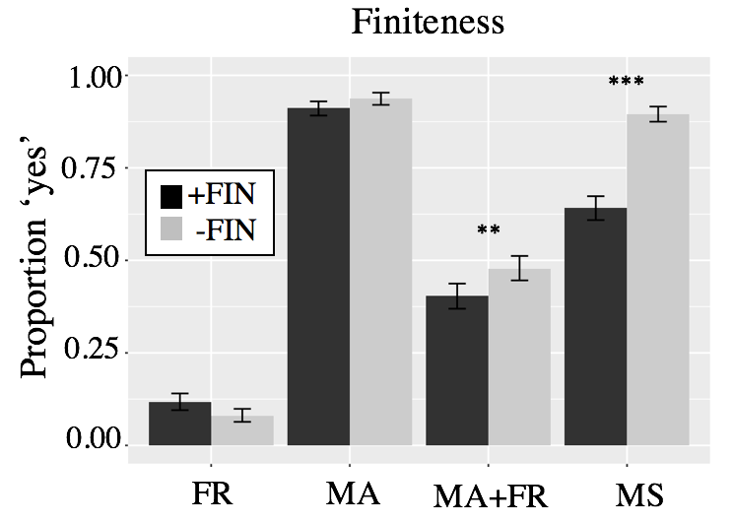
Mom knows where they found the people hiding
Jimmy knows where
to find the people hiding
False
MA
Mixed
T+F
MS
Notes:
EXPLAIN X AXIS IN ORDER

Slide 23
Mom knows where they found the people hiding
Jimmy knows where
to find the people hiding
False
MA
Mixed
T+F
MS
Notes:
Here are results. on the y axis is proportion 'yes' reponses to the test sentences....The x-axis graphs context. So the let most bars are the False controls, where a character proffers negative answers as true, represented by blue letters. the next bars over show the MA condition, which were true controls. The second from right are conditions where a subject has a false belief. And the far right are the Mention-some condtion trials, where a character presentes one true answer. We see here a significant difference between finite in black and nonfinite in grey.

Slide 24
Significant effect
of FIN in MS (X²(1)=83.642, p<.0001)
Mom knows where they found the people hiding
Jimmy knows where
to find the people hiding
False
MA
Mixed
T+F
MS
Notes:
Here are results. on the y axis is proportion 'yes' reponses to the test sentences....The x-axis graphs context. So the let most bars are the False controls, where a character proffers negative answers as true, represented by blue letters. the next bars over show the MA condition, which were true controls. The second from right are conditions where a subject has a false belief. And the far right are the Mention-some condtion trials, where a character presentes one true answer. We see here a significant difference between finite in black and nonfinite in grey.

Slide 25
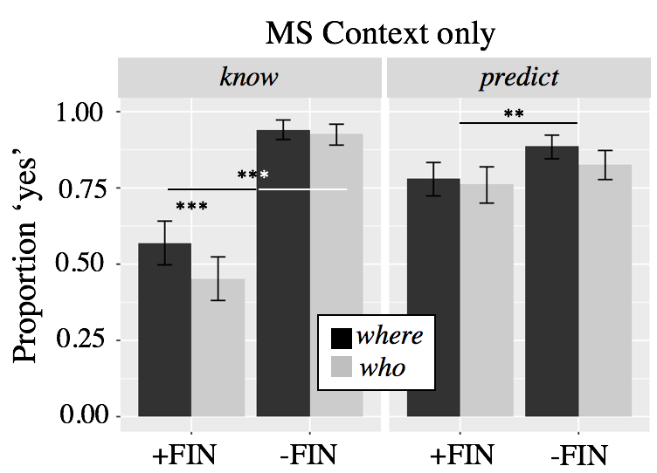
Mom knows where they found the
people hiding
Jimmy knows where to find the people hiding
Mom predicted where they found the people hiding
Jimmy predicted where to find the people hiding
Notes:
I mean there’s a significant difference in predict but +FIN predict is 75% acceptable, so it’s not really degraded acceptability here
With know, it IS degraded, clearly

Slide 26
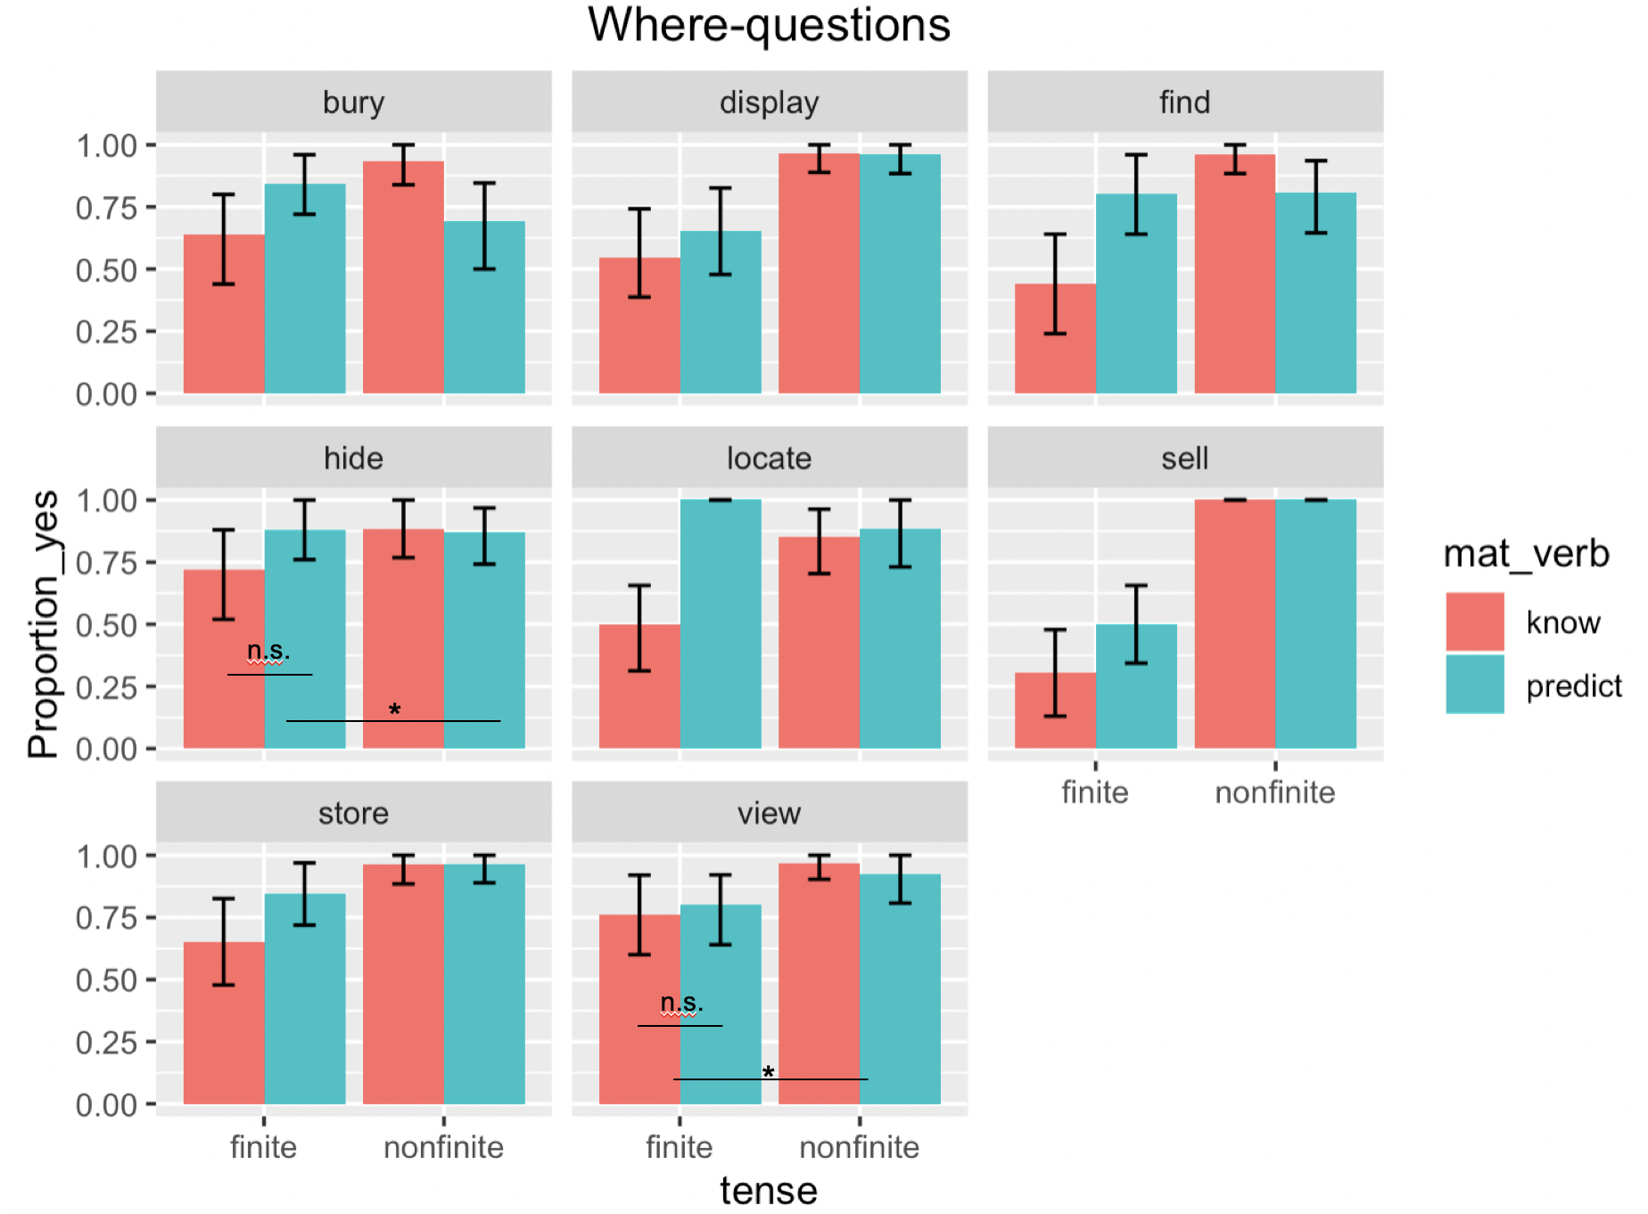

Slide 27
Where-viewed
Zack and Joe are going on vacation to California and want to see the Hollywood sign.
Zack’s mom asks his dad, “Where do you think they will view the sign?” His dad responds, “I think Beachwood Canyon.”
Actually, they go to Beachwood Canyon, Lake Hollywood Park, and the Griffith Observatory, but not Downtown or Runyon Canyon Park.
Mom reports, “Dad {knows/predicted} where they viewed the Hollywood Sign.”
Is Mom right?

Slide 28
Where-hid
Davey eats too much chocolate. He went to Costco the other day and bought a bulk pack- age of Ferrer Roché. He asks his friend Mackenzie to hide the chocolate for him.
Ruth asks Davey, “Where do you think she will hide the chocolate?” Davey says, “I think in the linen closet.”
In fact, Mackenzie hid the chocolate in the dresser drawers, in the linen closet and inside Davey’s suitcase, but not in the freezer.
Ruth reports, “Davey {knows/predicted} where she hid the chocolate.”
Is Ruth right?

Slide 29
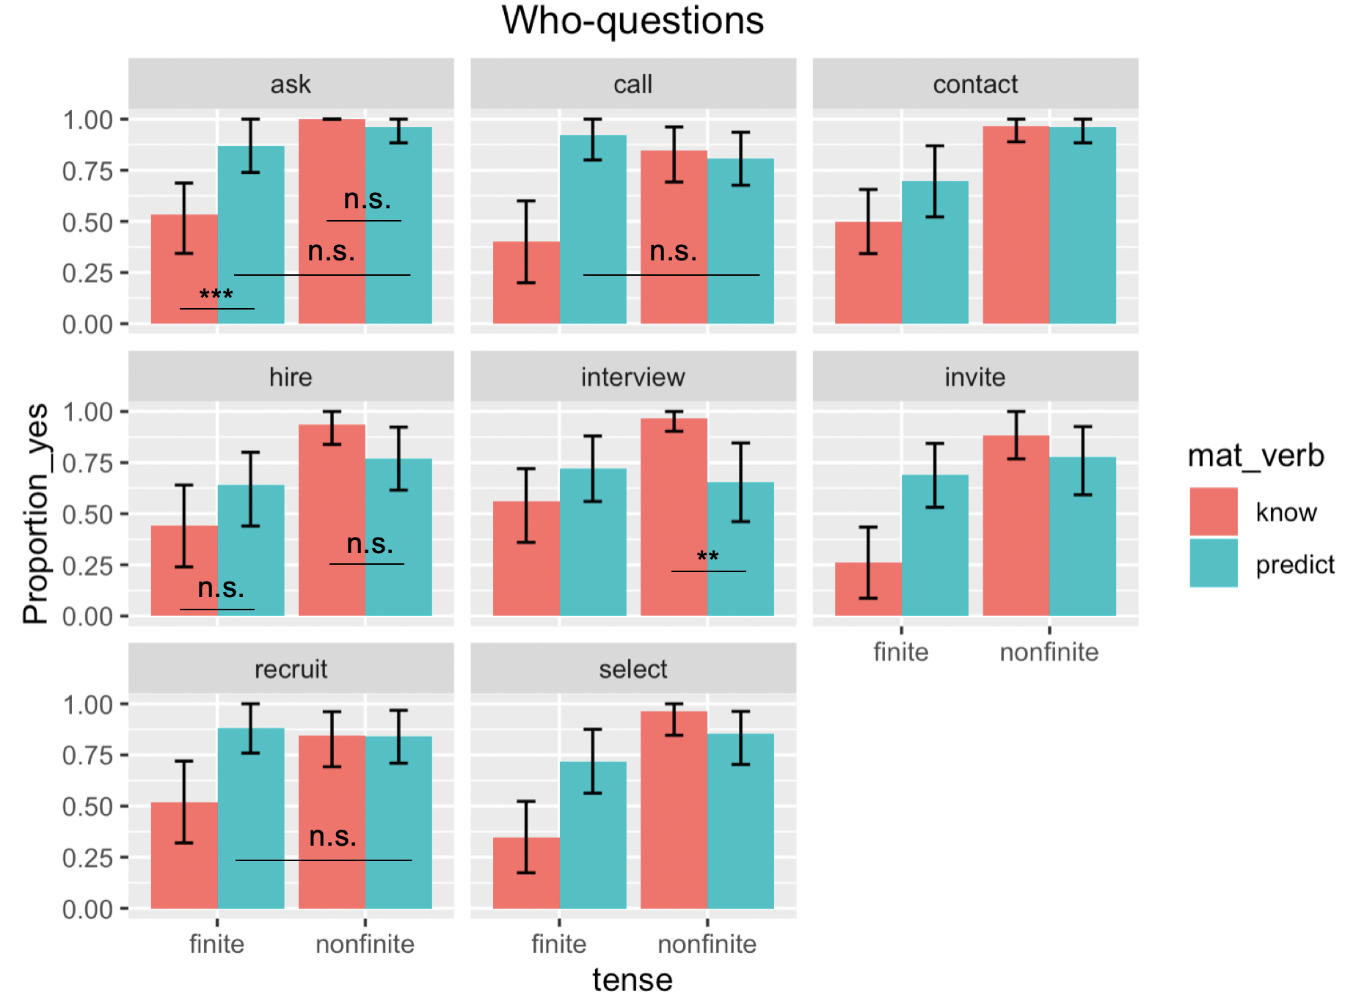

Slide 30
Summary | Experiment 1
Significant differences due to all Form Factors.
Finiteness x Verb (X²(3) = 118.66, p<0.0001)
+FIN: know-wh less acceptable than predict-wh
Maybe consistent with lexical semantic/selectional restrictions from the verb Grimshaw 1979; Heim 1994; Zimmermann 2010; George 2011; Spector & Égre 2015

Slide 31
Modal is not a categorical factor
If we rely solely on grammar for licensing mention-some, we make the wrong predictions about finite predict-wh questions.
H1 is strong. (too strong?)
Context.
(Interesting effects of individual test scenarios!)
Notes:
The lack of a modal doesn’t deliver categorical ungrammaticality.

Slide 32
Resolving a speaker’s goals Ginsburg 1995; Asher & Lascarides 1998; van Rooij 2003
# MA
☞MS
Further, only informative MS answers are felicitous.
Goal = have a cup of coffee
Goal = interview all cafes in town
☞MA
# MS
Notes:
Another long-noted robust observation is that whether a Mention-some answer or interpretation is acceptable will be determined by some kind of non-exhaustive discourse goals.
The classic demonstration of this is "Where can I find an Italian newspaper?" but I like to use this example cause it lets me make a joke about aaron.
is the tourist vs. the entrepreneur.

Slide 33
Contextual manipulations
Contextual Stakes | whether lives are at risk. (Not the only natural way to understand goals)
High vs. Low Stakes
Answer ranking | how informative is the answer. reducing uncertainty (Shannon 1948; van Rooij 2003, 2004) Not asymmetrical entailment between answers (cf. Fox 2014)
Number of MS answers given (single MO, or multiple MS)
How much information is in the answer (max or min)

Slide 34
A local apartment building has caught on fire. The landlord’s floor plan shows the following breakdown of tenants per floor:
Floor A has 10 tenants,
Floor B has 8,
Floor C has 5,
Floor D has 2,
Floor E has 1, and
Floor F has 0.
The fire chief is deciding where to send his firefighters, because there are people trapped but they don’t know on which floors.
Max Informative
“ABCDE”
“AB”
“A”
“DE”
“E”
MA
MS
High Stakes
-FIN
MO
MS
MO
Min Informative

Slide 35
He asks his firefighters, “Where should we go to find the trapped people?”
Firefighter A says, “Floor A.”
Firefighter B says, “Floors A, B, C, D, and E.”
Firefighter C says, “Floors D and E.”
Max Informative
“ABCDE”
“AB”
“A”
“DE”
“E”
Min Informative
Who knows where to go to find the trapped people? (Choose all that apply)
Firefighter A Firefighter B Firefighter C None of the Above
Notes:
We called this a high stakes condition because lives are at risk
A low stakes example would be finding coffee.
We have a study actually which compares MS in embedded questions with bare plurals and with DDs
There is no effect

Slide 36
Hypotheses
H1 | Answer acceptability will depend on Stakes.
MA > MS/MO in High Stakes
MS(/MO) in Low > in High Stakes
MA in Low Stakes: MA ≥ MS(/MO), van Rooij

Slide 37
Hypotheses
H2 | MS/MO acceptability will depend on Informativity.
Max MS/MO Answers more acceptable than Min MS/MO.
MS > MO (van Rooij)
Notes:
≥ because he admits that MS can be as acceptable as MA if utility is balanced by a least effort principle which favors MS over MA

Slide 38
Experiment 2 | Context vs. Form n=318 (6 excluded for non-native English; 6 for browser incompatibility issues)
Created in Ibex Farm
Run on MTurk
Within subjects:
Stakes
Answer type
Informativity
Between Subjects
Finiteness
High
Low
Mention-One (MO)
Mention-Some (MS)
Mention-All (MA)
Max
Min
Notes:
6 excluded for non-native speaker status, 6 for browser incompatibility issues

Slide 39
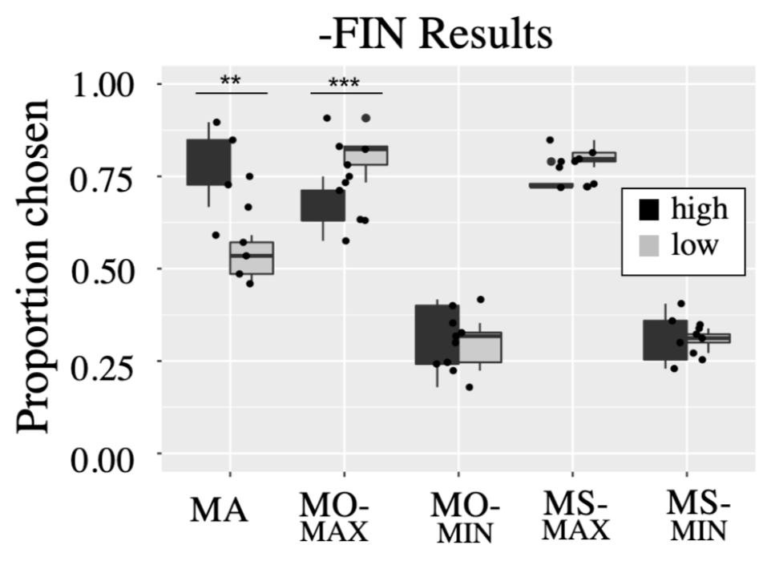
Non-Finite Clauses
Max Informative
“ABCDE”
“AB”
“A”
“DE”
“E”
MA
MS-MAX
MO-MAX
Who knows where to eat out?
MS-MIN
n.s.
MO-MIN
Min Informative
Interaction between
MA /MO-max and Stakes.
MS vs. MO not signf’t
Informativity of MS/MO significant.
MS vs. MA in High Stakes not signf’t
MA
MO-MAX
MO-MIN
MS-MAX
MS-MIN
Answer
Notes:
Discourse goals can make exhaustivity acceptable or not
Ignore the stakes manipulation for a second.
Low stakes, happy with mention most or mention one, but crucially hate the mention all
- bad for yimei because MA should be acceptable
If it’s a strong notion of mention-one, then we shouldn’t see AB in low stakes
High stakes doesn’t mean just mention-all, but mention enough (mention more than one)
- if HS requires MA, wouldn’t see acceptability of AB (MS)
- not MA driving the bus, it’s mention-ENOUGH

Slide 40
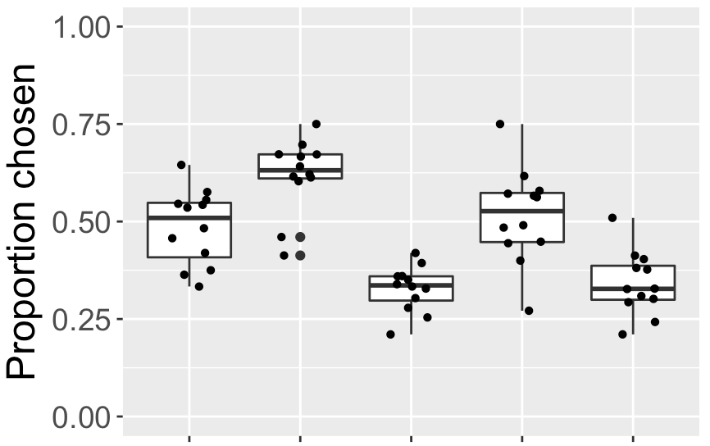
Finite Clauses
Max Informative
“ABCDE”
“AB”
“A”
“DE”
“E”
MA
MS-MAX
MO-MAX
Who knows where Dana ate out?
MS-MIN
MO-MIN
Min Informative
***
MO-max more acceptable than MA
Informativity of MS/MO significant.
MS vs. MA not significant
MA
MO-MAX
MO-MIN
MS-MAX
MS-MIN
Answer
Notes:
Here we say the same thing
Even though responses are generally depressed, the relationship between MA and M-AB is the same

Slide 41
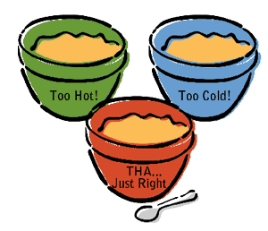
Summary | Experiment 2
MA is dispreferred in Low Stakes.
MOST information isn’t always best.
Even in +FIN(-Modal) questions
Participants calculate a threshold of informational sufficiency relative to contextual goals.
Notes:
Third point: It looks like there are “thresholds” for acceptability in both the low and high stakes cases. In the high stakes case, you have to minimally answer ‘AB’, but AB+ will do (i.e. ABCD). In the low stakes case, you have to minimally answer ‘A’, but more is fine (AB), however all is too much information – it violates the pragmatic goals in place.
Why is the threshold in the high stakes case AB? Well potentially because the guideline speakers are using is something like “give some significant percentage of the people” (maybe the most people on the least floors). But crucially, despite the high stakes there is no strong requirement to identify ALL the answers.
Why would the low stakes cases have a threshold of ‘A’ – well because it is a maximally informative answer (it isn’t something that is really low on the usefulness scale), but it also isn’t something that has to be maximally informative in the same way that the high stakes cases require (the one good answer is enough, we don’t need enough good answers to meet some threshold of having enough coffee)

Slide 42
Ex3a & Ex3b | conditional probability of answers
Experiment 3a | P(MS/MA | Form)
Form (wh, modal) significant
MS acceptable but degraded (like Ex1)
Task effect (likelihood vs. acceptability)
Experiment 3b | P(MS/MA | Stakes, Form)
Form (modal) not significant
Stakes x Answer*** but only for MS/MO
General preference for MA
Notes:
Using stimuli from Ex1 and 2, respectively

Slide 43
C. Whither exhaustivity?
(Non-)exhaustivity resolution and the speaker-hearer dynamic

Slide 44
Taking stock | dual licensing
There’s a “semantic” component | -FIN (modal) clauses do boost acceptability of MS.
Interaction with embedding verb (wh-word too)
But these are not categorical effects
There’s a “pragmatic” component | acceptability of MS/MA conditioned on Stakes
Relative informativity trumps absolute exhaustivity

Slide 45
Uncertainty in dialogue
Underspecified meaning:
(non-)exhaustivity
referential domain
granularity
specificity
Excuse me, where can we find coffee?
The hearer must reason about
the meaning of the linguistic signal
speaker’s goals/plan
Private and not always made explicit

Slide 46
Cues in the linguistic signal
Did the speaker ask (a), (b), or (c)?
(a) Where can we find some coffee?
(b) Where are all the coffee shops?
(c) Where can we find coffee?
P(MS) > P(MA)
P(MA) > P(MS)
P(MA) ≈ P(MS)
Additional information needed!
Notes:
But note that context can also change the likelihood of MS and

Slide 47
Cues from the speaker?
Cooperative speakers might be maximally informative wrt to their goals by producing cue-heavy utterances
But this is not so (Corpus & Production study)
Consistent with many other psycholinguistic findings (Clark & Wilkes-Gibbs 1986; Brennan & Clark 1996; Kehler & Rohde 2018; Kehler et al 2008; Arnold et al. 2004; Ferreira & Dell 2000; Ferreira & Hudson 2011; Ferreira & Schotter; Jaeger 2010, 2011; Ferreira 2019; Wu & Keyser 2006; Keysar et al. 2003; Lin et al., 2010; Keyser et al., 2000)

Slide 48
Summary | Interim discussion
Context, world knowledge and hearer expectations fill in goal-relevant information and resolve (non-) exhaustivity.
The linguistic form of a question provides a defeasible cue to goals, in virtue of hearer expectations.

Slide 49
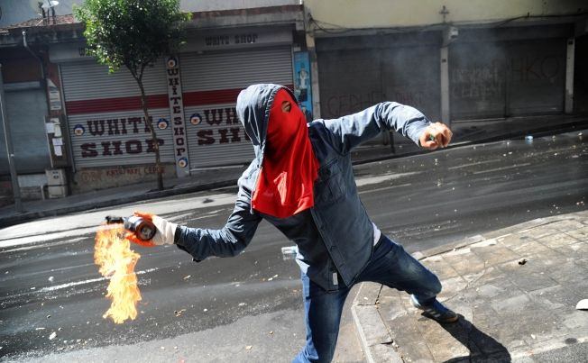

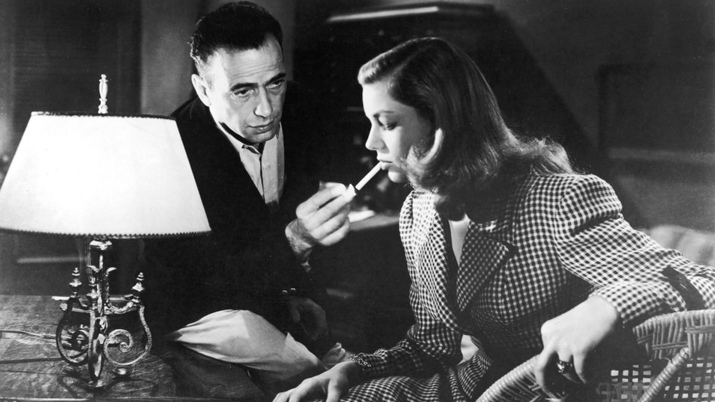
World knowledge and expectations (Degen 2015; Degen & Tanenhaus 2015; Goodman & Stuhlmüller 2013; Degen, Tessler & Goodman 2015; Zondervan, Meroni & Gualmini 2008; Tonhauser, Bever & Degen in press, a.o….)
Who has a light?
Notes:
I didn’t talk about this, but there was a lot of variation in Ex1 and Ex2 based on the individual test items---effects of Story

Slide 50
Why MS seems constrained.
Question forms encode default baselines for MS/MA. (Ginzburg 1995; Asher & Lascarides 1998)
Who-questions, and know-who are “default” MA.
How-, why-, and where-questions are “default” MS.
Defaults do not reflect the underlying semantics.
Notes:
If theories only focus on one kind of data, it will skew what appeaks to be the “baseline interpretations” for all questions.

Slide 51
“Default” MA
MA defaults reflect a strategy to be as informative as possible.
“Make your contribution as informative as is required” (Grice 1975, Quantity 1)
For who-questions | generally easy (cognitively?) to construct MA answer set (cf. Asher & Lascarides 1998; Lascarides, p.c.)
Notes:
We often already constrain this set from our common ground

Slide 52
“Default” MS
Goldilocks non-exhaustivity. (Ex2) (cf. Schulz & van Rooij 2006; Zimmermann 2010)
“Do not make your contribution more informative than is required” (Grice 1975, Quantity 2)
For why-, how-, where-questions | difficult to construct MA answer set (cf. Asher & Lascarides 1998; Lascarides, p.c.)

Slide 53
Speakers produce ambiguous, underspecified, vague, difficult utterances
They often give vague provisional descriptions that are refined over the course of the discourse (Clark & Wilkes-Gibbs 1986; Brennan & Clark 1996)
Pronouns are highly ambiguous, yet incredibly common, and learned early (Kehler & Rohde 2018; Kehler et al 2008; Moyer et al 2014)
Garden-path sentences are difficult for hearers to parse, yet very frequent in speaker productions (Arnold et al. 2004; Ferreira & Dell 2000; Ferreira & Hudson 2011; Ferreira & Schotter; Jaeger 2010, 2011; Ferreira 2019)

Slide 54
Informative contexts
Speakers don’t often recruit their theory of mind to reason about their hearers’ mental states…
…when the context is informative (Wu & Keyser 2006)
…it is cognitively demanding to do so (Keysar et al. 2003; Lin et al., 2010)
Sometimes speaker consider referents despite lack of mutual knowledge between hearer (cf. Keyser et al., 2000)

Slide 55
Experiment 3a 2x3x2(x3) Factorial Design
12 Test trials, with embedded know-questions
Between-subjects factors:
Task (Likely, Accept)
Answer (MS, MO, MA)
Modal (modal, nomodal)
Within-subjects:
WH (who, where, how)
32 Fillers
Pseudo-randomized in a Latin-square, 12 lists
Notes:
Task: Accept, Likely

Slide 56
Experiment 3a
Designed using Qualtrics (Provo, UT)
Run on Amazon Mechanical Turk
Workers restricted to US location
HIT accept rate greater than or equal to 99%
HIT completion at 1,000 or above

Slide 57
Two tasks
“How likely is X to give an answer like ____?”
“How acceptable is it for X to give an answer like ___?”
6-point Likert scale (unacceptable/unlikely to acceptable/likely)

Slide 58
Likely, who-nomodal-MO
The Paris Hotel only accommodates seven people in a hotel room. The Vellucis have decided to go on vacation and stay in a fancy hotel. Mom and Dad allowed Amanda to invite three friends to come on vacation with them.
Amanda invited Jenny, Buster, and Janice, but not Robbie or Sally.

Slide 59
Likely, who-nomodal-MO
Mom asks Dad, "Who did Amanda invite?”
Based on Dad's answer, Mom concludes,
"Dad knows who Amanda invited."
How likely is it that Dad gave an answer like, "Jenny"?
WH
-Mod
Answer
Task

Slide 60
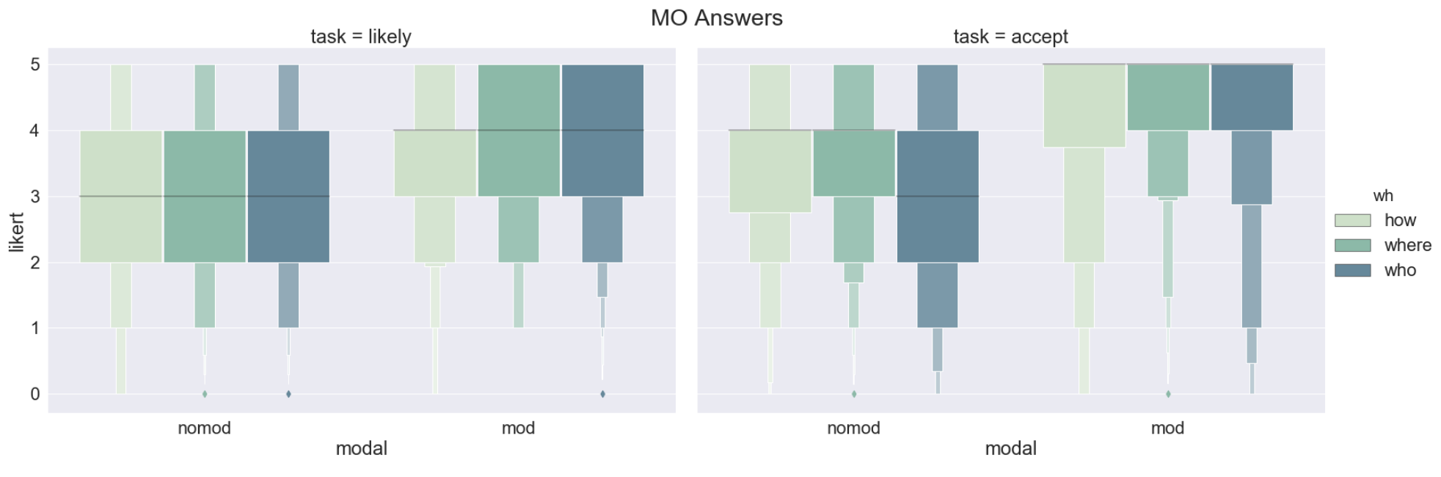
Results – MO Answers

Slide 61
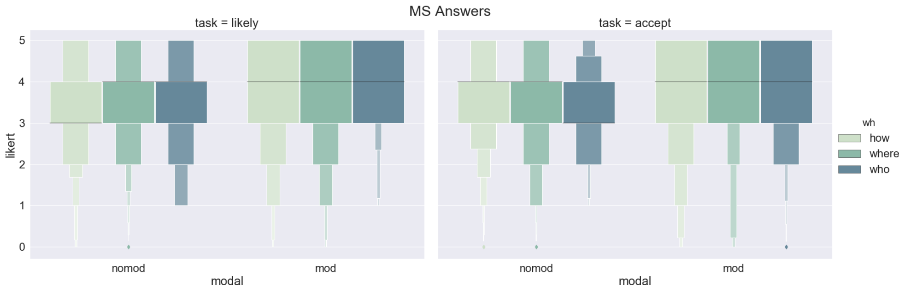
Results – MS Answers

Slide 62
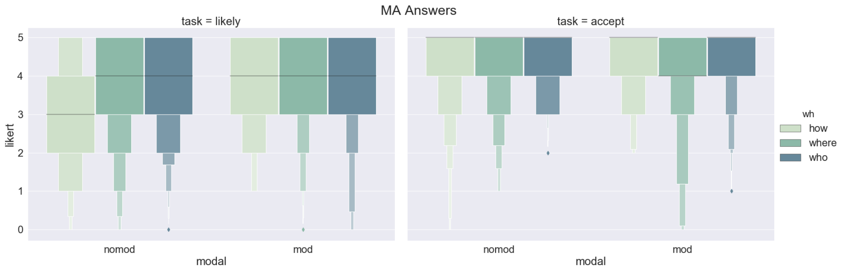
Results – MA Answers

Slide 63
Predictions
MO/MS answer conditions should receive higher ratings for Modal questions (cf. Modal Hypothesis)
MO/MS answer conditions should receive lower ratings for NonModal questions
MA answer conditions should receive high ratings across the board
Notes:
The first two fall out from the idea that modal questions are what drive MS/MO acceptability.
The third falls out from the general sense that exhaustive readings are generally available for any question

Slide 64
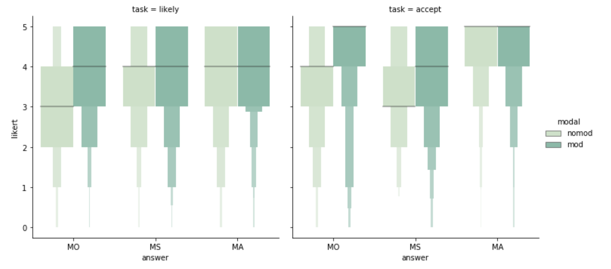
Overall
NonMod MS/MO medians degraded wrt MA
MS/MO Medians still 3 or higher!
In MO: NoMod degraded wrt Mod
Notes:
Upshot of 3rd: modal seem to be a really strong cue
But the lack of a modal doesn’t preclude the acceptability of MO → and interesting it doesn’t preclude the unacceptability of anything.
Modal upshot:
Important for MO
Modal in MS = task dependent?
Not important for MA
The modal plays no effect with MA (RUN THE R STATS ON THIS)’
We haven’t seen wh-word differences. The next three slides look at that.

Slide 65
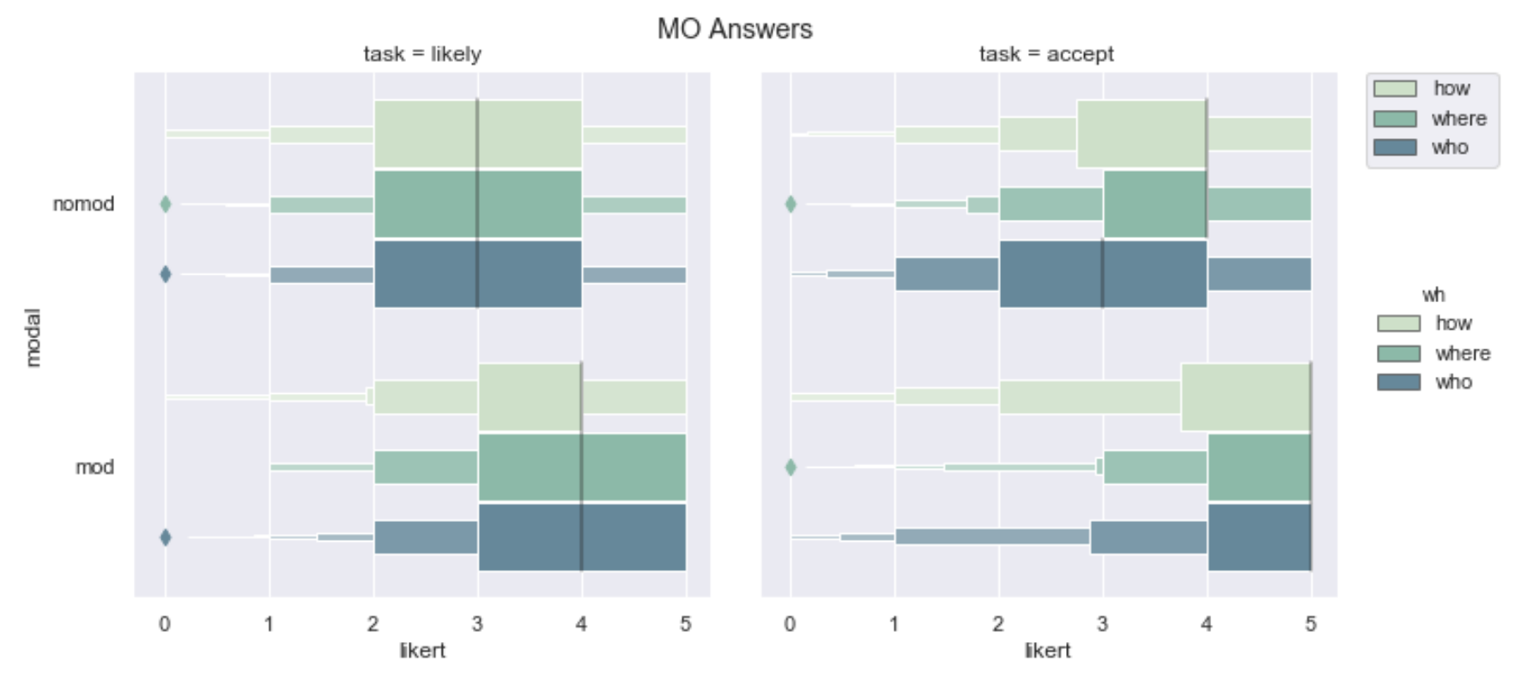
MO Answers
Consistently, NoMod degraded wrt Mod
NonMod who degraded in Accept Task
Lower medians for Modals in Likely Task
Notes:
2. NoMod who is degraded WRT other wh in Accept, but not Likely
3. Lower medians for all Modal wh-q in Likely but not in the Accept Task
This suggests that there was indeed a good concern for separating out these tasks.

Slide 66
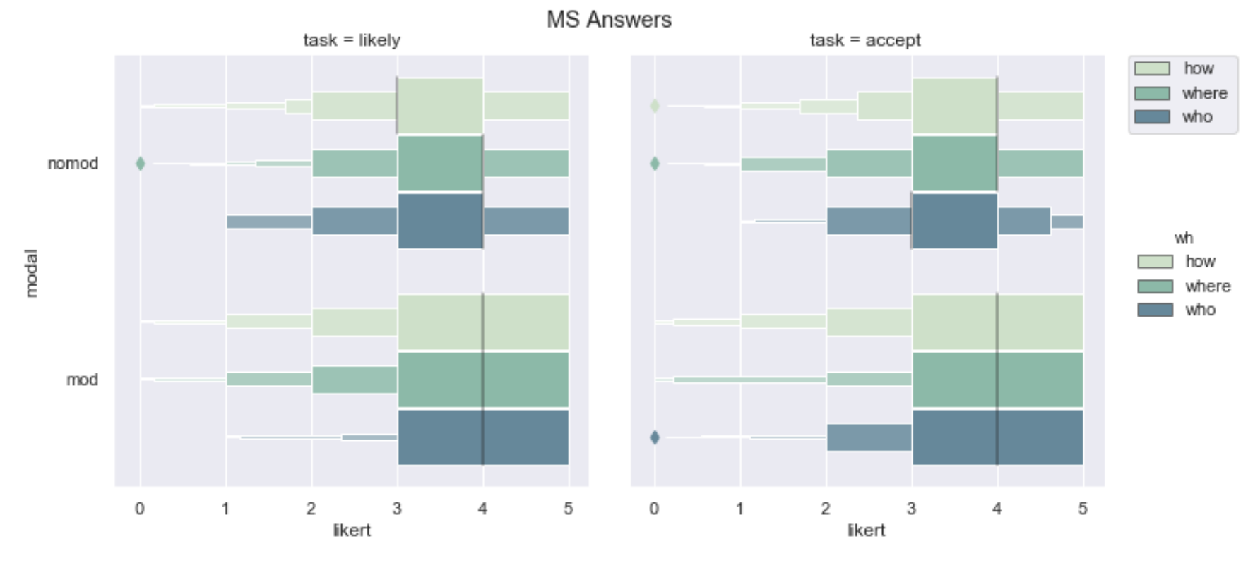
MS Answers
Not many differences across Factors!

Slide 67
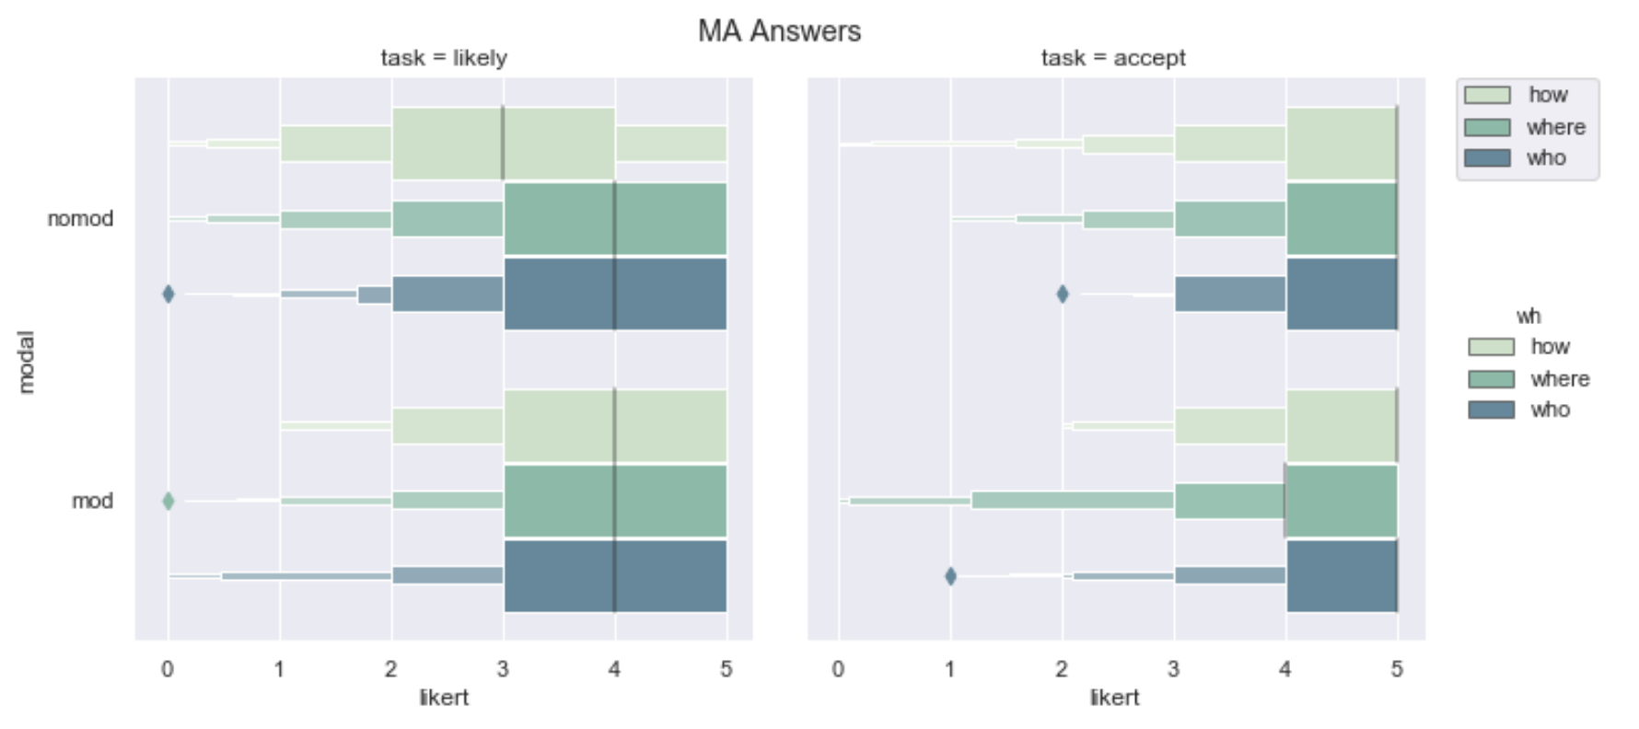
MA Answers
Lower medians in Likely Task
NoMod How degraded wrt other WH in Likely Task
Notes:
IN MA again we see a stiking similarity to MS, just as in Experiment 2.
This is surprising for any theory that says either MO or MA
But there are some small differences that weren’t present in the MS

Slide 68
Task differences
How likely is Ans|Form?
Lower means overall
Answer*** (X²(2)= 17.261, p<0.0002)
Modal*** (X²(1)= 43.691, p<0.0001)
Wh-word*** (X²(1)= 19.206, p<0.0002)
How acceptable is Ans|Form?
Higher means overall
Answer*** (X²(2)= 129.52, p<0.0001)
Modal*** (X²(1)= 24.87, p<0.0001)
Wh-word (X²(1)= 1.6813, p=0.4)

Slide 69
Summary | Experiment 3a
The Likert rating of an answer is sensitive to form factors
BUT ratings for all answers were generally high –medians were all above ‘3’
Do the Task differences track a particular kind of contextual evaluation sensitivity (cf. Roberts, 2017)?
Notes:
We saw some differences, but they weren’t on the order of acceptable versus unacceptable, but more like really acceptable, or “I could take-it-or-leave-it” acceptable
We saw some task variation which may suggest that when you alter people’s goals in a task, it affects their judgements of a answer’s felicity.

Slide 70
Experiment 3b (n=236)
2x4x2: Stakes (high,low), Answer (MA,MF,MS,MO), Modal (+,-)
12 stories (6 high, 6 low), 32 fillers
Latin square design to pseudo-randomize factors
Qualtrics survey software
Distributed on Mechanical Turk
US IP addresses
HIT approval rate ≥ 99%; # HITs completed ≥ 1000

Slide 71
Scientists have discovered a new strain of a dangerous virus that has contaminated oysters in the Mid-Atlantic. The Center for Disease Control is trying to prevent as much contamination as possible by tracking down the oysters which were sold to restaurants. The CDC supervisor is tasked with tracking down the oysters. With this goal in mind, she asks her task force,
“Where can we locate the contaminated oysters?” MODAL
“Where are the contaminated oysters located?” NOMODAL
In fact, the oysters were delivered to Restaurants A, B, C, and D, but not Restaurant E.
Please rate the acceptability of the following answer to the Supervisor’s question.
“Restaurants A, B, C, and D.”
“Restaurant A.”
“Restaurants A and B.”
“Restaurant E.”

Slide 72
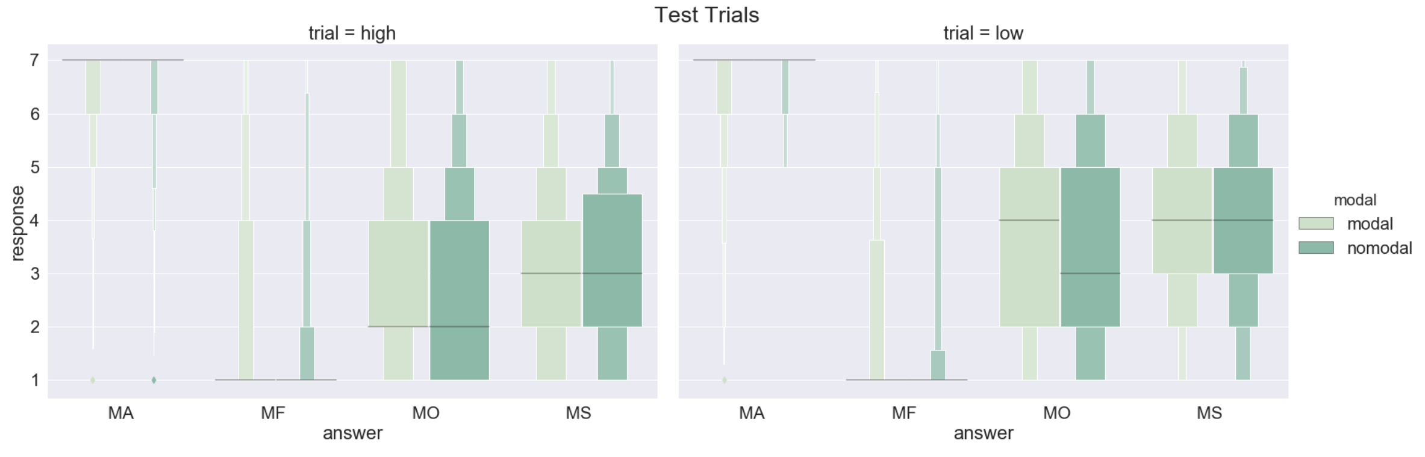
Results Experiment 3b
stakes (X²(1)= 86.79, p<0.0001)***
answer (X²(3)= 49.775, p<0.0001)***
interaction (X²(3) = 130.41, p<0.0001)***
modal (X²(1) = 2.366, p=0.4), n.s.
Variance
Notes:
Nowhere was Modal significant

Slide 73
A Corpus Study
Cues are probabilistically linked to interpretation. The distribution of a cue, or cue co-occurrence, may effect the robustness of an interpretation (Degen & Tanenhaus 2015, 2016, 2018; Degen 2015; Elman, Hare, McRae 2004; MacDonald, Pearlmutter & Seidenberg 1994; Seigenberg & MacDonald 1999; Tanenhaus & Truswell 1995; McRae & Matsuki 2004, a.o.)
Understanding the input is useful for determining what language learners are exposed to (cf. Syrett 2007; Dudley 2017)
Notes:
Today’s work is really focused on ongoing corpus work
Why make this move? Well corpus work is important for two reasons.
CLICK
#2 The second idea comes from the processing literature.
Cues to speaker’s meaning are probabilistically linked to interpretation. Thus, the distribution of a cue, or cue co-occurrence may effect the robust ness of an interpretation.
Therefore, we can gather distributional data from the corpus search, and then conduct a follow-up study directly linking those cues to interpretation.
CLICK
#1 From an Acquisition perspective: Corpus work helps us understand the input
If I take a snapshot of what competent adult speakers are producing, it give us an idea of the likelihood of the cues to meaning that learners might hear.

Slide 74
Coding in corpus study
Question Type: root, embedded, relative clause, fragment, ambiguous
Embedding/matrix verbs: know, predict, be surprised, and most frequent
Clause Type: finite, modal, non-finite
Wh-word: who, where, how

Slide 75
Methodology
Ranga Tirumala
github.com/rangat/whAnalysis
Tagged for POS with NLTK POS tagger, and sentence tokenizer.
Pulled all sentences with who, how, where.
Applied a set of ordered heuristics to tag these sentences for Question Type and Clause Type.
Notes:
This allowed us to weed out extraneous sentences in principled ways.

Slide 76
British National Corpus (BNC)
over 6 million sentences
90% Written (over 6 million sentences)
Extracts from newspapers, journals, periodicals all ages
Academic books and popular fiction
Letters and memoranda
School and university essays
10% Spoken, 49,292 sentences
Orthographic transcriptions of informal conversations (demographically balanced)
Other contexts too, like business or government meetings, radio shows
Notes:
British English from the latter half of the 20th century
The corpus we’re using is the BNC. Here’s a little about it.
90% written and 10% spoken THAT’S ALL
DON’T READY SMALL BULLET POINTS

Slide 77
questType Heuristics (Exclusionary)
For a given sequence of words or POS tags:
4. If VB_{RC}_WH Relative Clause
5. If {RC}_WH Relative Clause
1. If ¬∃.VB in sentence Fragment
9. Else Ambiguous
Code available on github.com/rangat/whAnalysis
{RC} = Part-of-Speech tags for all phrases that can be RC heads
Notes:
~ 1 min/1min.5
EXCLUSIONARY Heuristics
grouped by what exactly they’re doing
The numbers beside them represent the order in which they were applied
The set {RC} denotes all the POS tags of phrases that can be relative clause heads
There were several ambiguous cases, but the present analysis we excluded these and leave for future analysis in a larger context beyond the single sentence.
CLICK

Slide 78
questType Heuristics (Inclusionary)
2. If {RC}_VB_ ¬{RC}_WH Embedded
3. If VB_WH and ¬S-Aux-Inv. Embedded
8. If VB_WH Embedded
6. If WH_{AUX}_{RC}_VB Root
Except: if WH_{RC}_{AUX}
Except: if {AUX}_VB_{RC}
7. If ‘?’ at end of sentence Root
Subj-Aux Inversion
Notes:
The things we wanted to include were root and embedded questions
Once tit was determined that a sentence wasn’t a fragment or a relative clause
EXPLAIN ROOT
Explain EMBEDDED

Slide 79
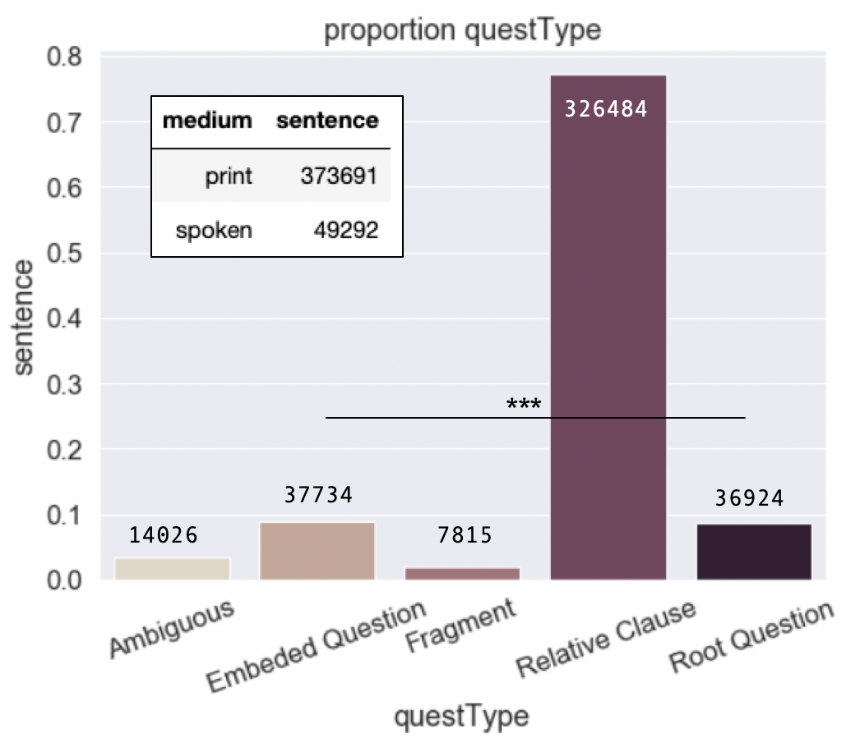
Composition of Corpus: questType

Slide 80
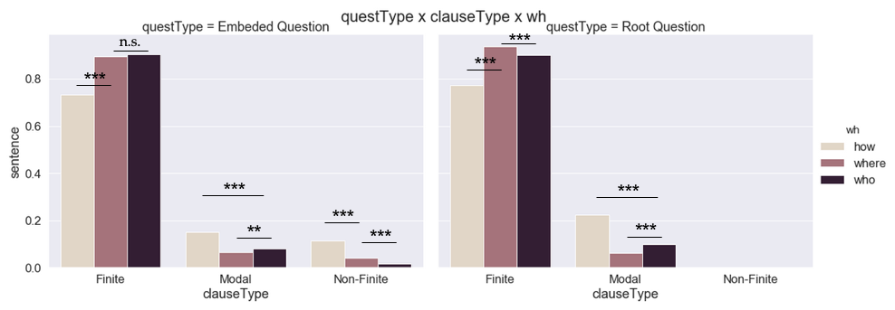
Of Root and Embedded Questions

Slide 81
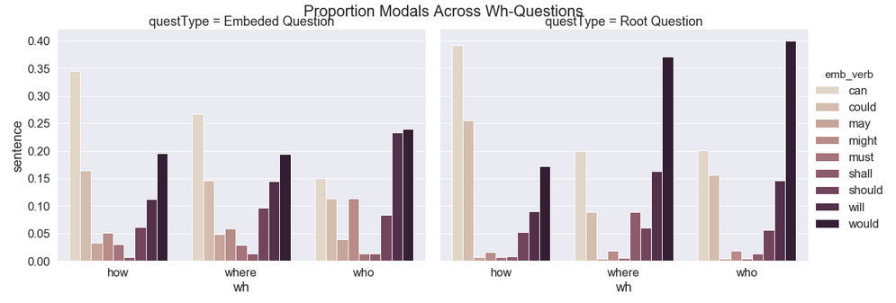
Modals
Embedded Questions
How + can
Where + can
Who + will/would
Root Questions
How + can/could
Where + would
Who + would

Slide 82
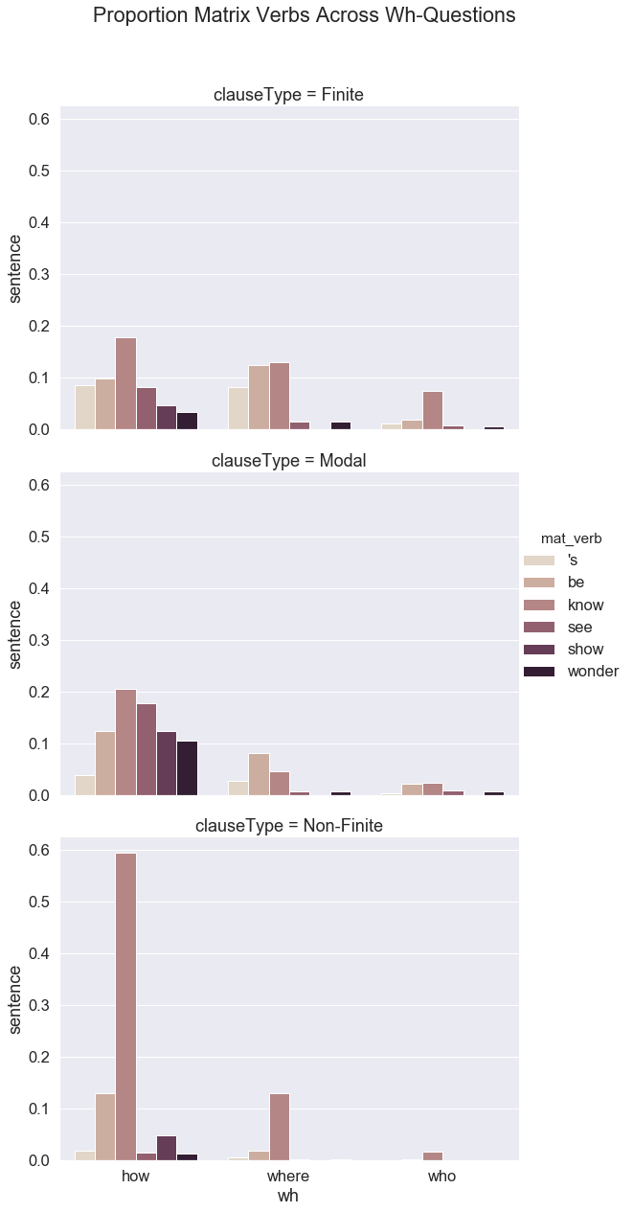
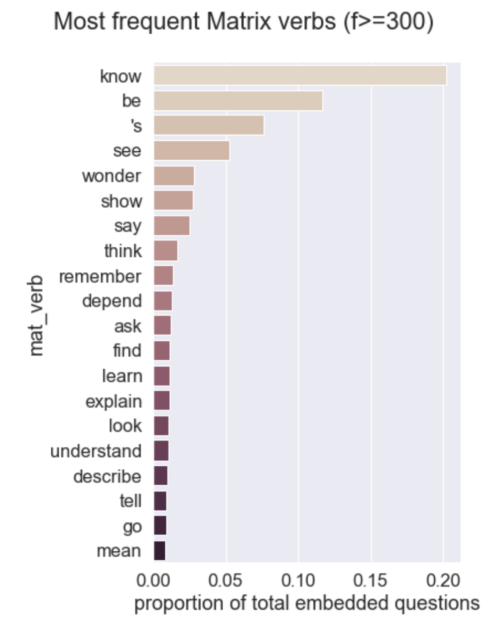
Matrix verbs

Slide 83
Discussion of Corpus
The co-occurrence data validate some intuitions from the literature….
Simplistic cues like +/- Modal, +/- Finite , wh-word clearly are not informative enough on their own
Let’s get a look at contextual goals and see how that directly effect question production
Notes:
BIG ASSUMPTION
We want to add meat to this assumption, that that is the purpose of our next study.

Slide 84
Experiment 4 – Production N = 56 (4 removed for non-native English status)
2 x 1 within-subjects factor Stakes (high, low)
12 test trials (6 high, 6 low), 32 fillers
Rutgers Undergrad Ling & Cog Sci pool
Data coded using procedure from corpus study

Slide 85
Predictions
In high stakes contexts (MA goals), we should find more productions of exhaustive cues.
Finite (non-modal) clauses, who-questions
In low stakes contexts (MS goals), we should find more productions of non-exhaustive cues.
Modal*/non-finite clauses; how/where-questions
*What kind of modal? Reliably existential priority modals can/could; still an open question about other modals; possibly should allows non-exhaustive readings (but not clear that these are not just domain restriction); it’s possible that existential epistemic modals (may, might) allow MS

Slide 86
Experiment 4 - Production
Scientists have discovered a new strain of a dangerous virus that has contaminated oysters in the Mid-Atlantic. The Center for Disease Control is trying to prevent as much contamination as possible by tracking down the oysters which were sold to restaurants.
The CDC supervisor is tasked with tracking down the oysters. With this goal in mind, she asks her task force something relevant to the locations of the contaminated oysters.

Slide 87
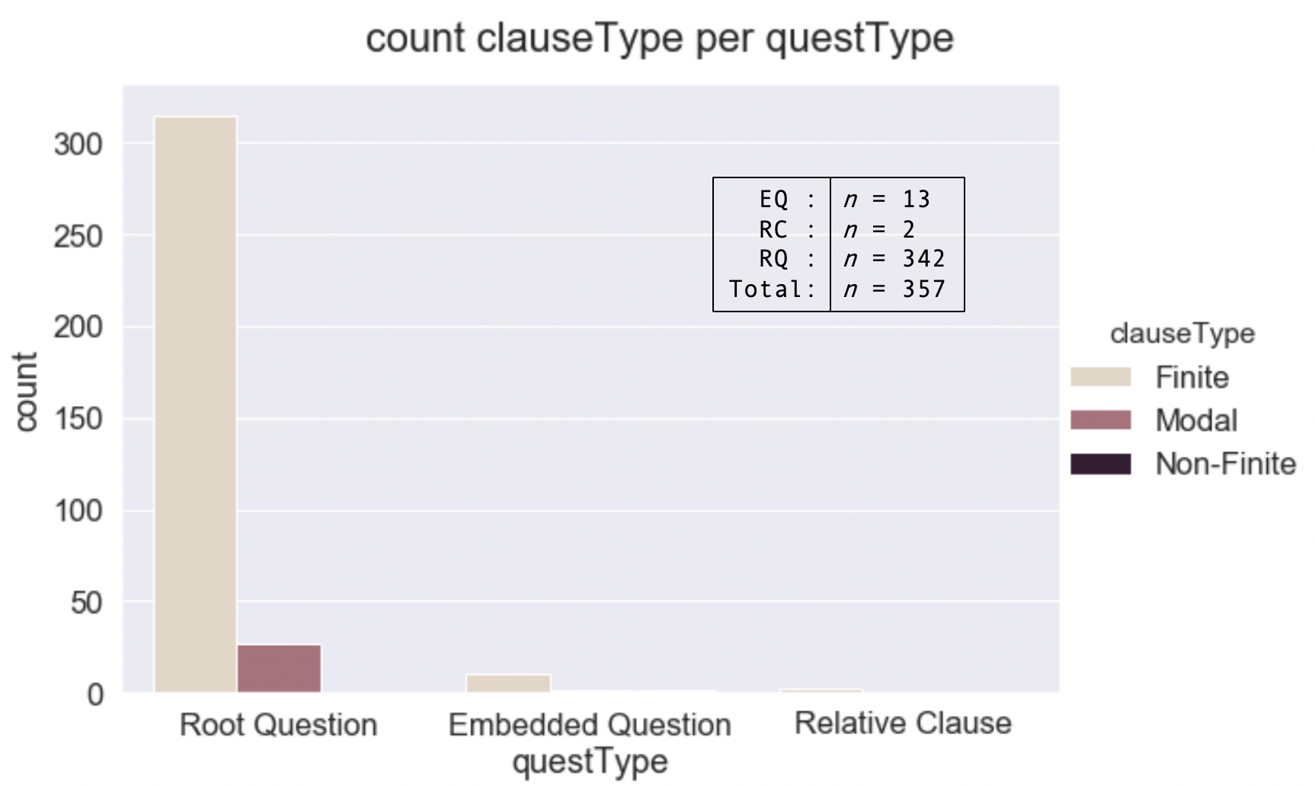
questTypes

Slide 88
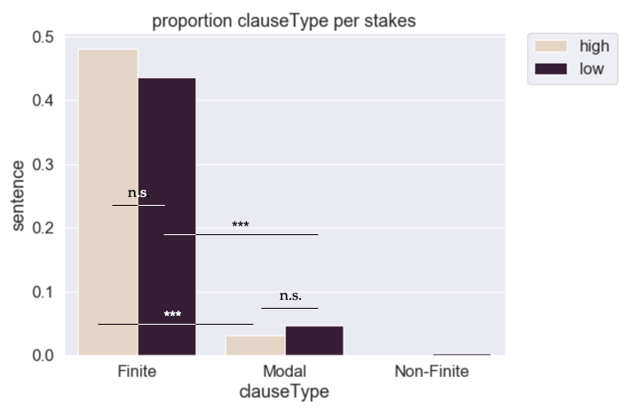
clauseTypes x stakes

Slide 89
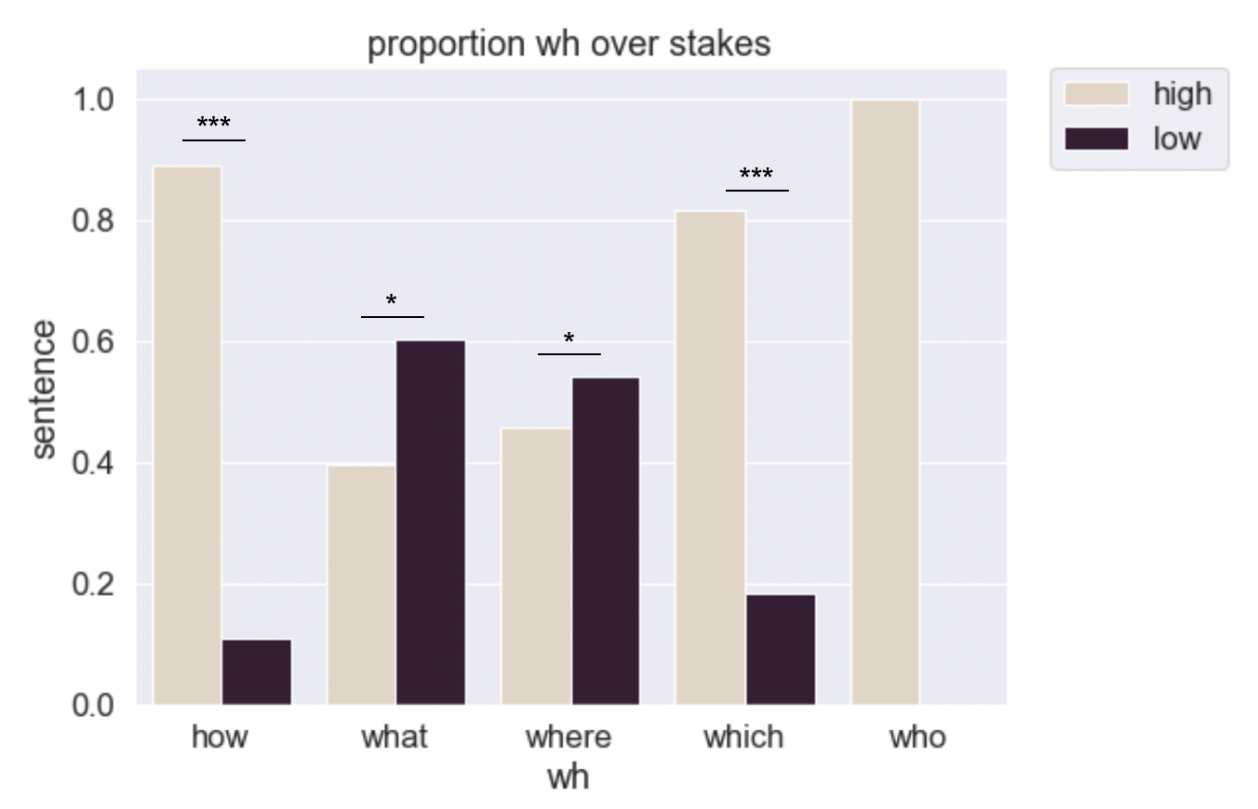
Wh-words

Slide 90
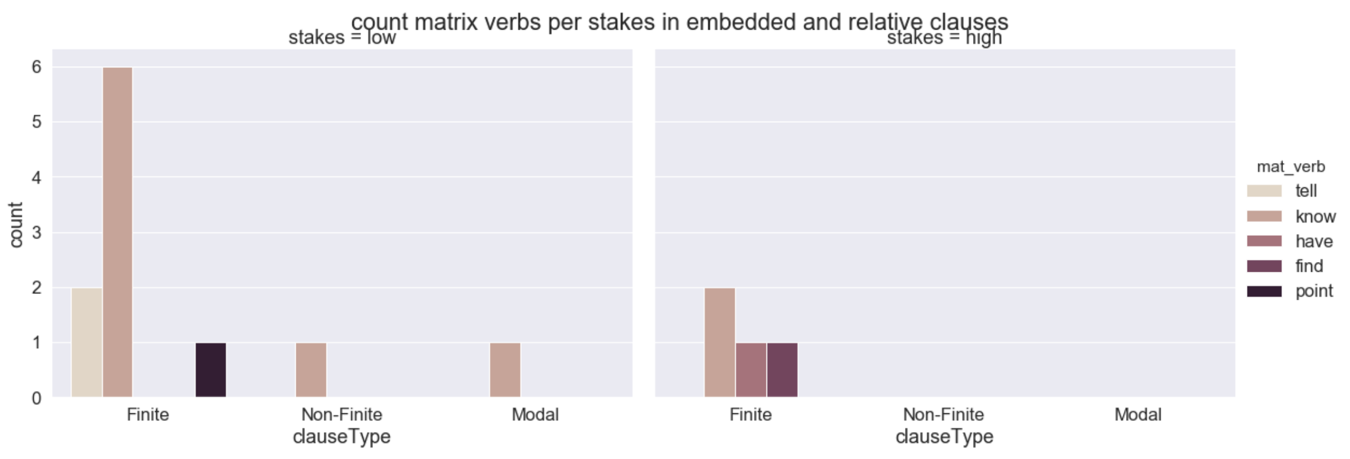
Matrix verbs

Slide 91
Unhelpful speakers, helpful contexts
Speakers don’t often recruit their theory of mind to reason about their hearers’ mental states…
…when the context is informative (Wu & Keyser 2006)
…it is cognitively demanding to do so (Keysar et al. 2003; Lin et al., 2010)
Sometimes speaker consider referents despite lack of mutual knowledge between hearer (cf. Keyser et al., 2000)

Slide 92
Speakers produce ambiguous, underspecified, vague, difficult utterances
They often give vague provisional descriptions that are refined over the course of the discourse (Clark & Wilkes-Gibbs 1986; Brennan & Clark 1996)
Pronouns are highly ambiguous, yet incredibly common, and learned SUPER early (Kehler & Rohde 2018; Kehler et al 2008; Moyer et al 2014)
Garden-path sentences are difficult for hearers to parse, yet very frequent in speaker productions (Arnold et al. 2004; Ferreira & Dell 2000; Ferreira & Hudson 2011; Ferreira & Schotter; Jaeger 2010, 2011)

Slide 93
D. Hearer types | diagnosing (non-) exhaustivity
Experiment 5
Notes:
We’re kind of at a stalemate. We know there are linguistic constraints and we know there are contextual licensing.

Slide 94
Informative Contexts Hypothesis
When the explicit context is informative wrt a Goal, a hearer does not need to rely on cues in the question
When the explicit context is under-informative wrt a goal, then hearers more likely to rely on the form of the question to provide a cue to goals

Slide 95
Differences between hearers
Do differences within hearer groups predict (non-) exhaustivity resolution?
Are these hearers differentially sensitive to linguistic vs. contextual information?
Notes:
If we know a hearer is more inclined to be literal, maybe we can use them to diagnose the literal meaning of question wrt exhaustivity

Slide 96
Experiment 5 n = 240 (14 removed)
Under-informative
goal
Implicit contexts
Typical card game goals are MA
Card game context (Cremers & Chemla 2017, 2018; Chemla & George 2018)
Goal (MA, MS, none) x Modal (-,+)
Results:
Goal *** (MS/MO Answers in MS Goal)
No effect of Modal, even in No Goal
No Goal context ≈ MA Goal

Slide 97
Card Game Task cf. Cremers & Chemla (2017), Chemla & George (2017)
Between:
Goal (MA, MS, None)
Within:
Answer (MS, MO, MA, MF)
Modal (Mod, NoMod)
Verb (say, know)
16 different predicates (card properties)
16 unique trial types (32 trials total)
pseudorandomized in 16 x 16 Latin square

Slide 98
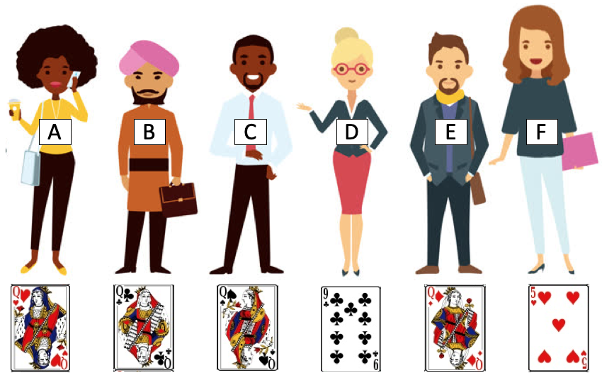
Modal
Who can play a Queen?
NoMod
“Who has a Queen to play?”
Dana: “A”
Melissa: “Dana knows who has a queen to play”
MO
Verb
Say
Dana said who has a queen to play

Slide 99
No Goal Instructions
*
Some friends have gotten together to play a game of cards. Dana and Melissa have never played cards before. We will ask Dana a question, and she will give an answer. Then Melissa will say something about what Dana said. Your task is to say whether you agree or disagree with what Melissa says.
During training:
Who has a Queen to play?

Slide 100
MA Goal Instructions
Some friends have gotten together to play a game of cards. The goal of this game is to collect points. If a player plays a certain card, they will receive a point. The players with the most points at the end can move on to the second round. Thus, it is important to keep an accurate account of the points.
During training:
Players with a Queen get a point. Who has a Queen to play?
Notes:
explain

Slide 101
MS Goal Instructions
Some friends have gotten together to play a game of cards. The goal of the game is to play a card that matches either the number, the color, or the suit of the current card. Players go one at a time.
During training:
Let’s say you play a Queen. Who has a Queen to play?

Slide 102


Caveat | Implicit contexts
Card games provide naturally exhaustive contexts because the end goal is typically point accrual, so there’s already a maximization of points in the air.
Participants will likely be biased to respond exhaustively, given the expectations about typical card game goals.
Notes:
I don’t think this is a problem for the experiment, but I think it means that the work is not finished.
For a more complete picture, then we would want to find a different baseline context that was typically non-exhaustive, and then manipulate Goal in the way we do here.

Slide 103
Predictions
In Informative contexts (MS/MA Goal), Modal should be neutralized.
MS/MO answers higher in MS Goal than in MA Goal
In Underinformative contexts (No Goal), Modal should be significant.
MS/MO answers higher in Modal vs. NoModal Questions
BUT CAVEAT!
No Goal ≈ MA Goal

Slide 104
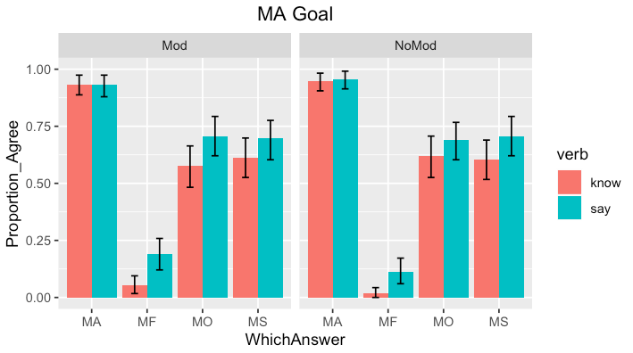
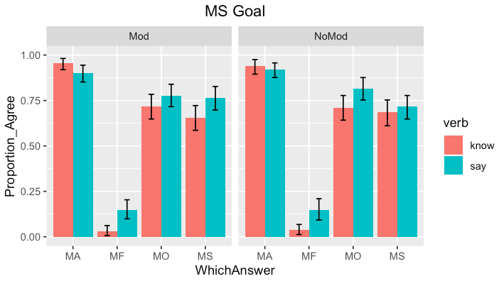
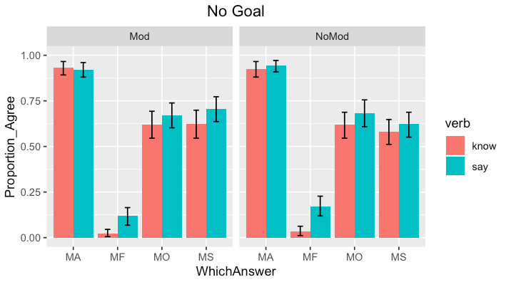
MS/MO Answers in MS Goal > in MA Goal
No s.d. between MA/No Goal
No effect of Modal in any condition (but small interaction)
Goal ** X²(2) = 12.324, p<0.005
Answer ***
X²(2) = 12.324, p<0.0001
Verb***
X²(1) = 30.705, p<0.0001
Goal x Modal*
X²(5) = 12.447, p<0.03

Slide 105
Logical vs. Pragmatic hearers Bott & Noveck (2004)
Some cats are mammals
logical meaning
Some and possibly all cats are mammals
pragmatic meaning
Some but not all cats are mammals
TRUE
FALSE
Logical responders
Pragmatic responders
Notes:
And we could do this with Children too

Slide 106
Predictions
Logical responders will respond literally; pragmatic responders will respond pragmatically
MA theories | logical hearers reject MS; pragmatic hearers accept MS (Karttunen 1977; Groenendijk & Stokhof 1982, 1984)
MS theories | logical hearers accept MS; pragmatic hearers accept MA (Asher & Lascarides 1998; Beck & Rullmann 1999; George 2011)
Modal theories | logical hearers accept +Modal > –Modal; pragmatic hearers accept –Modal ≈ +Modal? (George 2011, Ch6; Fox 2014; Nicolae 2014; Xiang 2016)
Notes:
Assuming we can get a good measure of literal/pragmatic-ness…

Slide 107
Correlation n = 240 (14 removed)
Card game
Goal x Modal
Scalar implicatures Bott & Noveck (2004) replication
Presupposition projection Chemla & Bott (2013) replication
Experiment 5 Cremers & Chemla 2017; Chemla & George 2018
Goal***
Modal

Slide 108
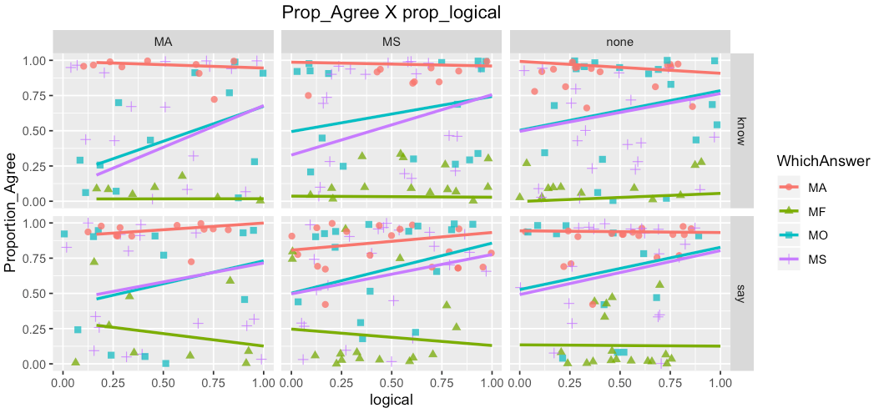
Correlation
Logical responders rate MS/MO significantly higher, near ceiling
r = 0.07, p < 0.0001***
X²(1) = 9.8278, p<0.005**
Logical Responders
Goal* X²(2) = 8.56, p<0.01
Pragmatic
Responders
Goal*** X²(2) = 30.59, p<0.0001

Slide 109
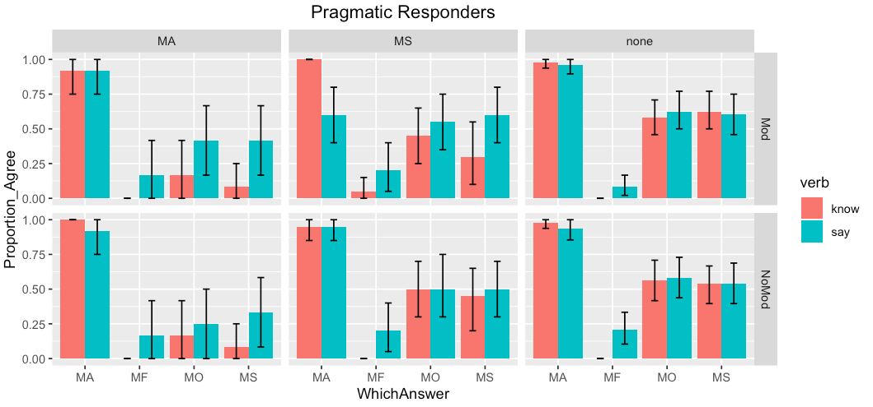
FALSE
pragmatic meaning
Some but not all cats are mammals
Some cats are mammals
Goal*** X²(2) = 30.59, p<0.0001

Slide 110
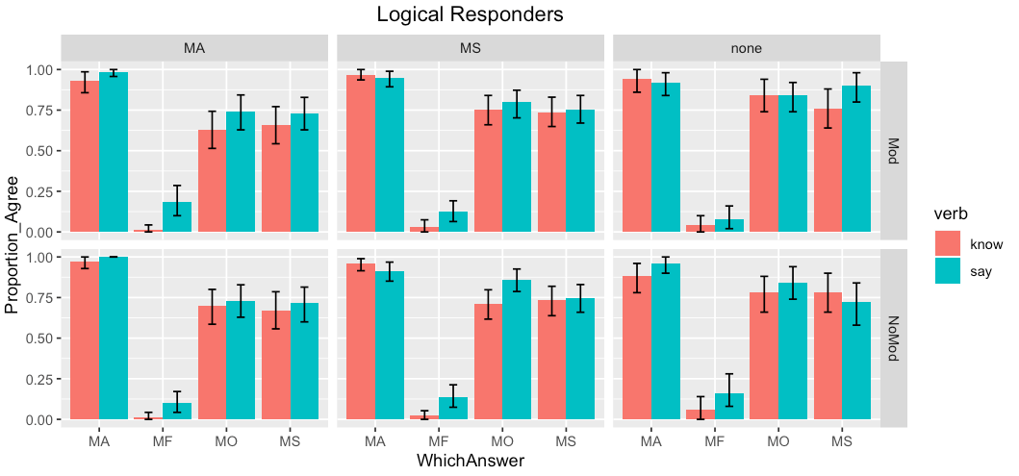
TRUE
logical meaning
Some and possibly all cats are mammals
Some cats are mammals
Goal* X²(2) = 8.56, p<0.01
Notes:
70% of participants are logical; 25% are pragmatics, 5% are at chance

Slide 111
Summary | correlation
Logical hearers rate MS/MO higher ATB than pragmatic hearers
Near ceiling, despite MA bias to context
Pragmatic hearers calculate exhaustivity inference cf. Schulz & van Rooij 2006; Spector 2007; Zimmermann 2010
“A” → “only A” (false in the experiment)
Both hearer types are sensitive to Goal Manipulation
Context-sensitivity at the literal level
No effects of modal! Not even in Logical hearers.

Slide 112
E. Whither semantics?
Final discussion and conclusion

Slide 113
(Non-)exhaustivity is resolved relative to contextual goals.
Inference under uncertainty: both the linguistic form of the question and the contextual goals are underspecified for (non-)exhaustivity
“Pragmatics” fills in missing information:
Linguistic signal modulates hearer expectations about typical goals
Trade-off between maximizing informativity with processing ease/computational load

Slide 114
Option 1 | underlying ambiguity (Beck & Rullmann 1999; George 2011, Ch.2)
(Covert) Lexical | ANS operators (Beck & Rullmann 1999; Lahiri 2002*; Theiler et al 2019?)
Structural | Presence/absence of EXH operator (George 2011, Ch.2)
Notes:
No matter your theory, context or “pragmatics” will play a crucial role! And this is compatible with two basic approaches. READ
In both cases you will need pragmatics to do the leg work. I think I have some reasons why you might prefer one over the other, and we can talk about that later. CLICK
Basically, the idea will be familiar to many people here. The hearer’s problem is to determine….

Slide 115
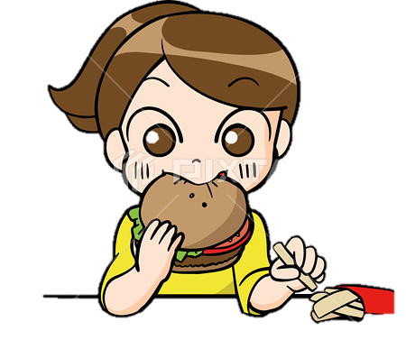



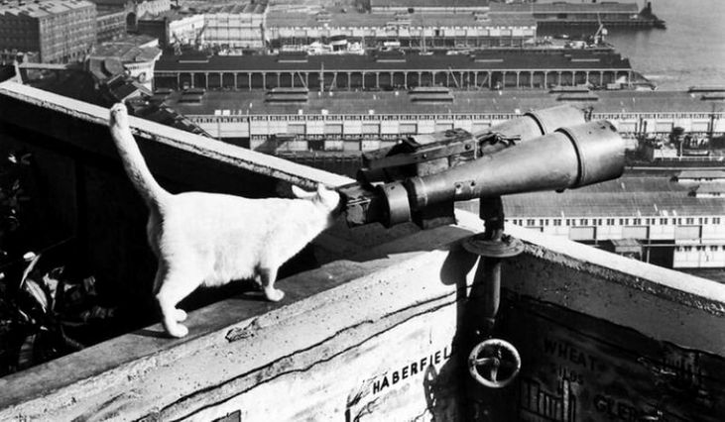

Pragmatics of disambiguation
(a) I’m heading to the bank.
(a’) I’m eating on the bank.
(b) I saw the pirate with the telescope.
(b’) I saw the cat with the telescope.
(c) The doctor sent for the patient arrived.
(c’) The flowers sent for the patient arrived.
,
Bring the patient!
Notes:
Verb choice
Noun choice
Subject choice
In all the three prime examples, lexical choice chnges the likelihood of one interpretation over the other

Slide 116
Option 2 | underlying univocality
Underspecified (context-sensitive variables) (Ginzburg 1995; Asher & Lascarides 1998*; Lahiri 2002*; van Rooij 2003, 2004)
Mention-Some (existential) (Asher & Lascarides 1998*; van Rooij & Schulz 2006; Zimmermann 2010)
Mention-All (universal) (Karttunen 1977; Groenendijk & Stokhof 1982,1984; Heim 1994; Dayal 1991, 1996; George 2011, Ch.6, Klinedinst & Rothschild 2011; Guerzoni & Sharvit 2007; Spector & Égre 2015…modal theories? Fox 2014; Nicolae 2014; Xiang 2016)
Notes:
No matter your theory, context or “pragmatics” will play a crucial role! And this is compatible with two basic approaches. READ
In both cases you will need pragmatics to do the leg work. I think I have some reasons why you might prefer one over the other, and we can talk about that later. CLICK
Basically, the idea will be familiar to many people here. The hearer’s problem is to determine….

Slide 117
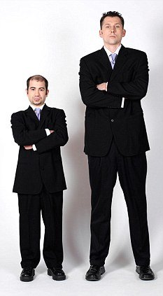
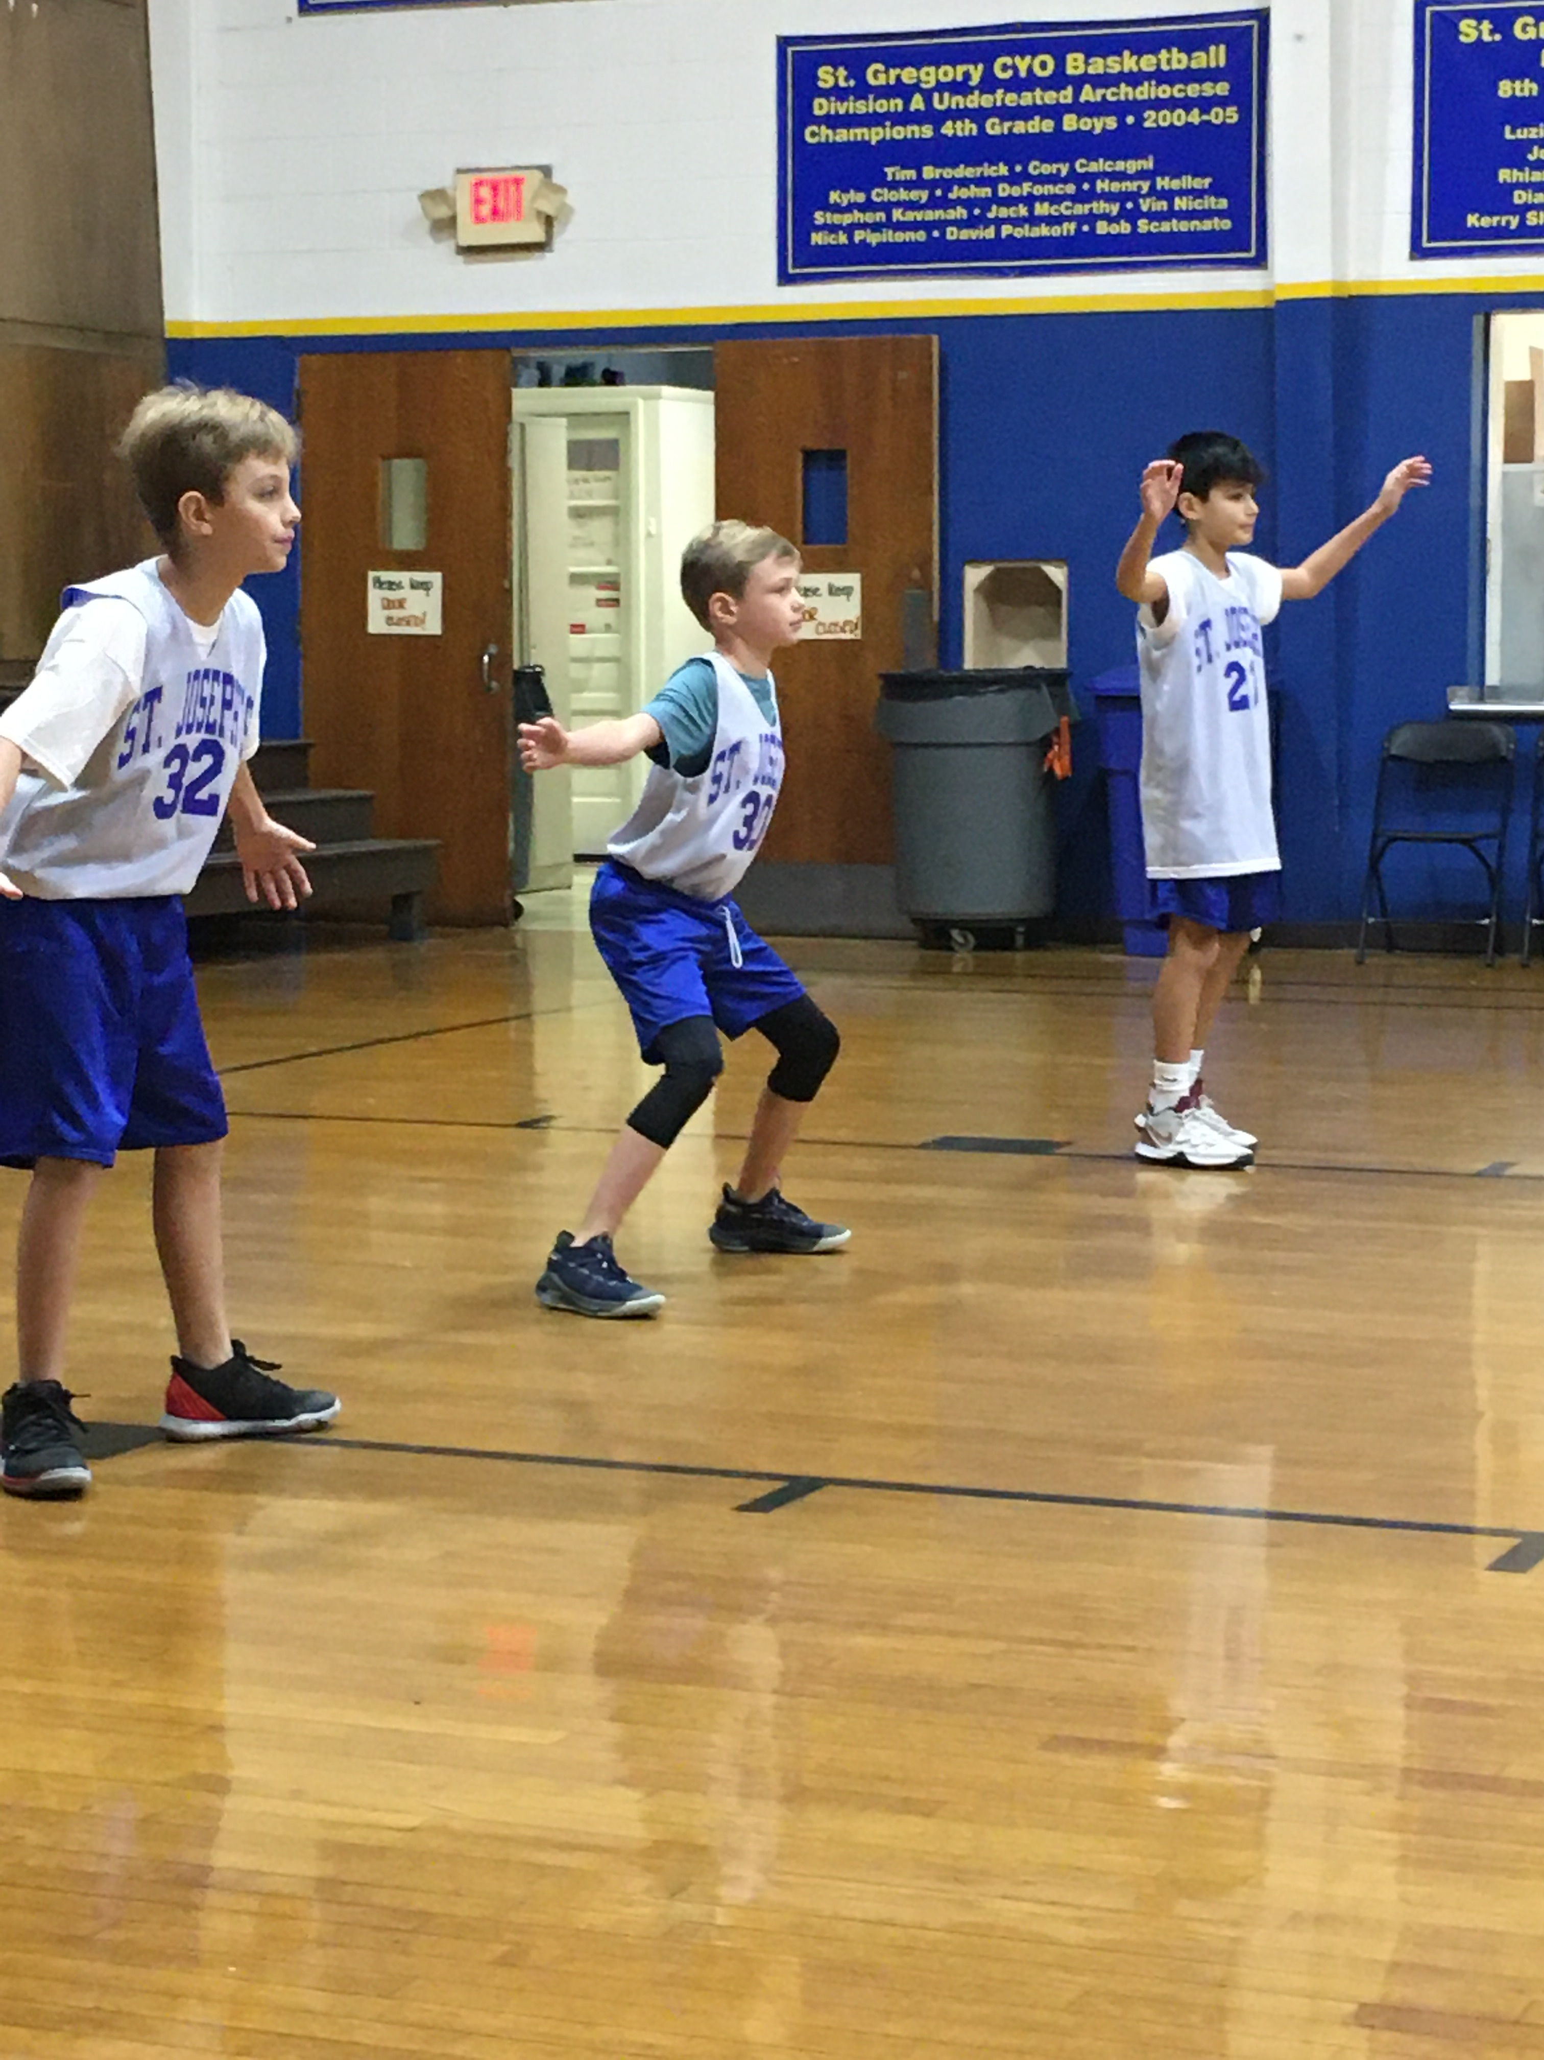
Pragmatics of univocality
Precisification / Anaphora
That is a cat.
I am speaking.
A linguist came to the party.
Bond might be upstairs.
Everyone goes to a local bar.
The house is red.
Indexical shift, Alok-utive agreement
Michael is tall.
Notes:
Precisification indexical shift and illocutive agreement

Slide 118
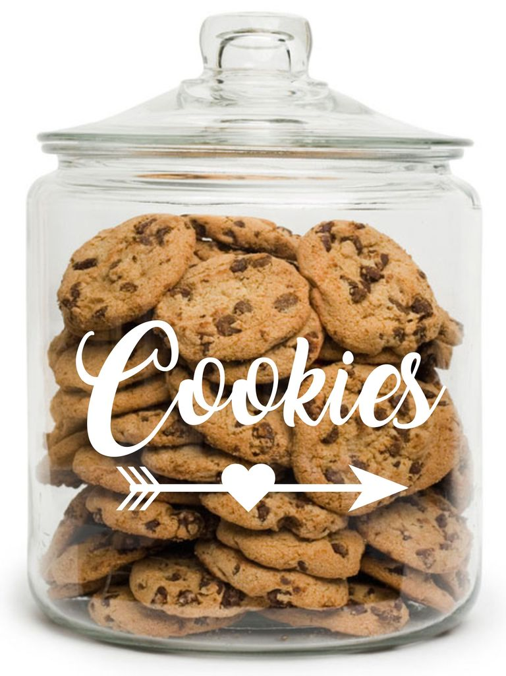
Pragmatics of univocality
Strengthening (MS → MA)
I ate broccoli. → I ate only broccoli.
I ate some of the cookies. → I did not eat all.
Grammaticalized
strengthening
Operator
(EXH)
General
extra-linguistic
(Abductive)
reasoning
Notes:
And it’s not quite clear that

Slide 119


Pragmatics of univocality
Weakening (MA → MS)
Everyone was at the party.
Who came to the party?
c
c
Reduces to option 1
Anaphoric
to subset in
common ground
(Rutgers Linguistics Dept, c.2014)
(EVERYone? Really?)
Speaker intentions
Notes:
Its possible that this weakening reduces to context-sensitive variables pragmatic

Slide 120
Conclusion
+ …
+ …
+ Weakening of MA
+ Strengthening of MS
You can mix and match!
Underlying ambiguity + general disambiguation
Underspecification + pragmatic strengthening
Experimental results show contextual variation, and interpretation not grammatically bound in predicted way
Lexical choice independently affects interpretation
Experiment 5 – differences between logical and pragmatic responders
General preferences for strengthening
MA generally implausible for how-, why-, where-questions
Notes:
Where does this leave us
Given experiment 3 it seems people’s judgements aren’t purely about form or about context
We see some judgements difference related to a modal, and some related to task differences
What do we want in our grammar? What do we want in our pragmatics?
Ambiguity a marker of efficiency? (cf. Piantadosi?)
Underspecification reduces cmopuational explosion (cf. Poesio…)
But there’s more work to be done to understand how exactly that works.

Slide 121
General Discussion
Acceptability of an answer is neither purely a form or purely a contextual matter. It’s a combination of the two.
(Non-)exhaustivity is not really semantics vs. pragmatics, because the two are dependent on each other for filling in missing information.
Notes:
Where does this leave us
Given experiment 3 it seems people’s judgements aren’t purely about form or about context
We see some judgements difference related to a modal, and some related to task differences
But there’s more work to be done to understand how exactly that works.

Slide 122



Thank you!
Kristen Syrett
Veneeta Dayal
Paul Pietroski
Yimei Xiang
Alex Lascarides
Vera Gor
Taylor Martinez
Rangaraj Tirumala
Divya Appasamy
Knyck Sutherland
Rutgers Lab for Developmental Language Studies Semantics-U-Name-it-at-Rutgers (SURGE)
Funding from NSF BCS-DDRIG #1918068 to Syrett/Moyer, Rutgers Off-Campus Dissertation Fellowship, Rutgers Aresty Research Center, and the Rutgers Center for Cognitive Science
All the RAs!
All the Grads!
Judith Degen, Aaron White, Malihe Alikhani, Tim Dawson, Sara Pixley,
Livia Souza, Augustina Owusu, Deepak Alok, Lydia Newkirk, Dine Mamadou

Slide 123
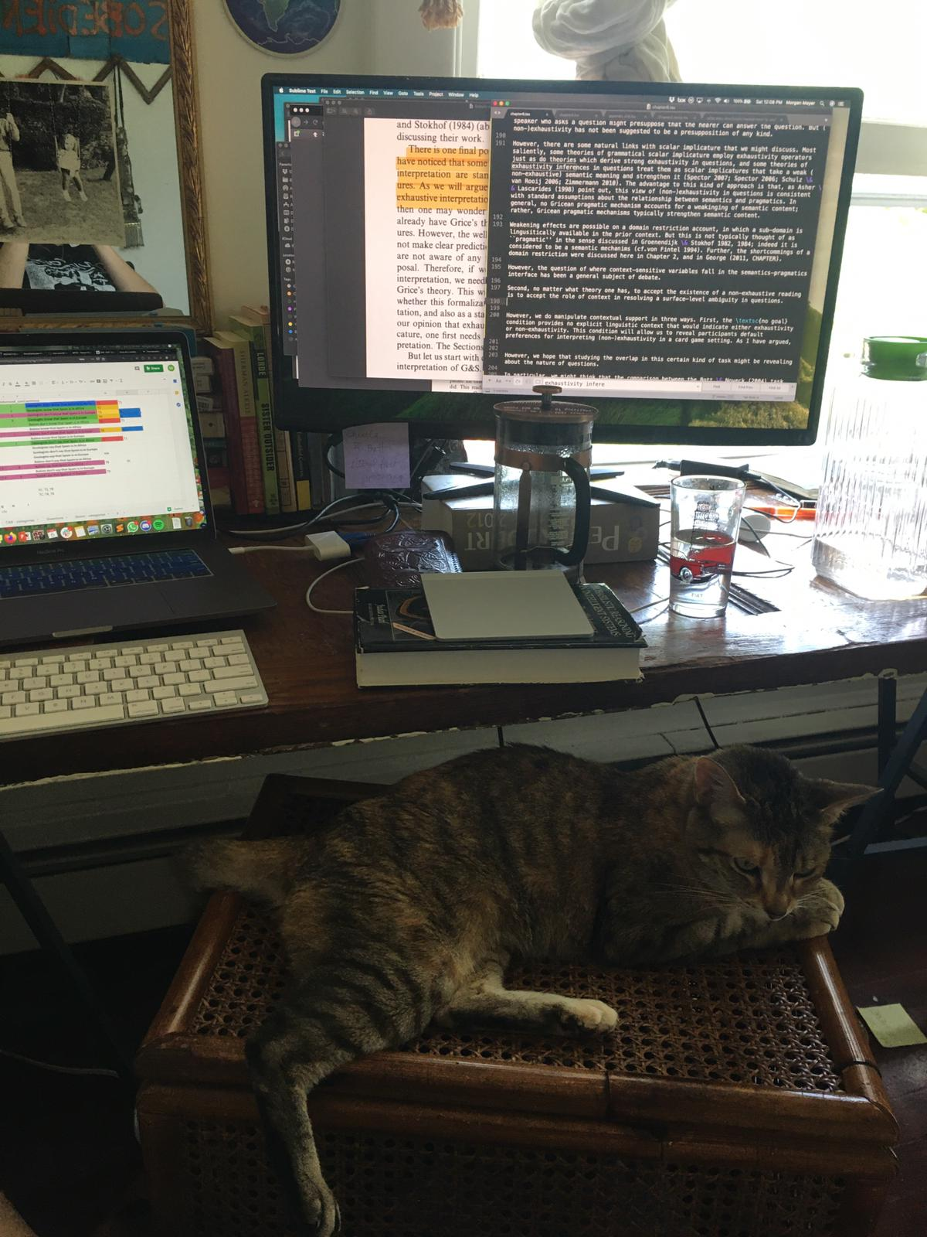

Slide 124
General Discussion
Acceptability of an answer is neither purely a form or purely a contextual matter. It’s a combination of the two.
Exhaustivity is not really semantics vs. pragmatics, because pragmatics is necessary at every level.
How information is privileged in dialogue, given task demands or goals (broadly construed).
Notes:
Where does this leave us
Given experiment 3 it seems people’s judgements aren’t purely about form or about context
We see some judgements difference related to a modal, and some related to task differences
But there’s more work to be done to understand how exactly that works.

Slide 125
Overriding plural marked which Ns Dayal (2016), p. 79
Suppose a researcher needs a few people with AB blood type to test a new drug. The study requires her to test some but not necessarily all the patients in the hospital. She has a list of patients but not their blood types. The researcher asks of the administrator who has the information mapping patients to blood types: Which (of the) patients can we approach for this test?
(1) You can approach Bill and Sue.
(2) Or you can approach Jim and Tammy.

Slide 126
The questioner’s mental state Ginzburg 1995
Who has been attending these talks?
Dana: A number of linguists and psychologists.
Dana’: [Lists the names of attendees]
How do I get to the buried treasure?
Dana: You go to the secret island.
Do I know how to get to the buried treasure?
Dana knows who the president of Mali is.
Notes:
Another example to drive the point home
Even the things we thought earlier HAD to be exhaustive can be non-exhaustive
If you think this is implicit domain restriction, I have an example for you to show that maybe that’s not it.

Slide 127
Granularity effects with where Ginzburg (1995)
Dana steps off the airplane in Helsinki.
Flight attendant: Do you know where you are?
Jill: Helsinki.
Flight attendant: Jill knows where she is.
Dana gets out of a cab at her hotel in Helsinki.
Cab driver: Do you know where you are?
Jill: Helsinki.
Cab driver: Jill doesn’t know where she is.
Notes:
this could maybe be construed as another manipulation of contextual goals, which also probably govern granularity
So while this may not apparently translate to a difference between MS and MA, we will should keep it in the back of our minds and something that does differ between them.

Slide 128
Granularity effects with who? Identity questions (Boër & Lycan 1975)
Luke’s about to fight a guy in a dark cape and helmet.
Leia: Do you know who he is?
Luke: Darth Vader.
Leia: Luke knows who he is.
Dana is working as a waitress at an event with celebrities.
X: Do you know who she is?
Dana (squinting at name tag):
Kim Kardashian.
X: Dana doesn’t know who she is.
Luke’s asking Obi-won about his parents when a guy in a dark cape appears.
Obi-won: Do you know who he is?
Luke: Darth Vader.
Obi-won: Luke doesn’t know who he is.
Notes:
this could maybe be construed as another manipulation of contextual goals, which also probably govern granularity
So while this may not apparently translate to a difference between MS and MA, we will should keep it in the back of our minds and something that does differ between them.

Slide 129
Not your average domain restriction
We have a friend, Mark, who had a party last night.
I am complaining to you that Mark only invites philosophers to his parties. You are defending him.
You: “Mark’s not a bad guy.”
Me: “…Oh yeah? Who came to the party last night?”
You: “Liv!” (a linguist)

Slide 130
Xiang & Cremers 2017
Modality (+,-) x Wh (who vs. which children)
Mary remembers
{which children/who} can lead the dance
{which children/who} have an accessory in common
In +Modal condition, there was an inferential step that was made explicit, but not so in the -Modal condition
-Modal was not a fully crossed factor
Wh-clauses were not minimal pairs
Notes:
But there were a couple problems with this study. The modal and nonmodal conditions weren't on an equal footing, in terms of how easy it was for the participant to judge target sentences....

Slide 131
EX1: +FIN know-where
Billy and his neighbors are playing hide and seek in the park. It is his turn to close his eyes and count to ten. After he is finished counting, he sees his classmate Jimmy, and asks Jimmy to help him find his friends. Mom and Dad are watching, and Dad asks, "Where do you think they will find the kids hiding?" Mom says, "I think under the slide, in the tunnel, and behind the swings." Actually, Jimmy's friends are hidden under the slide, in the tunnel, and behind the swings, but not in the tree. Dad reports, "Mom knows where they found the people hiding." Is Dad right?

Slide 132
EX1: +FIN know-who
Lisette just started working at a newspaper. She's researching a story on nuclear waste, and has to figure out who to interview. She and her mentor are considering Dawn, Jerry, Valentine and Allen.
The editor's assistant asks her, "Who do you think they will interview?" The editor says, "I think Dawn."
Actually, they interview Jerry, Valentine, and Allen, but not Dawn.
The assistant reports, "The editor knows who they interviewed for the story."
Is the assistant right?

Slide 133
EX1: -FIN know-who
Carolina just started working at a newspaper. She's researching a story on nuclear waste, and has to figure out who to interview. She is considering Dawn, Jerry, Valentine, and Allen.
Actually, Jerry, Valentine, and Allen all are truthful and helpful people, but Dawn is a notorious liar. Carolina asks her mentor Veronica who to interview.
Veronica says, "Dawn." Carolina reports, "Veronica knows who to interview for the story."
Is Carolina right?

Slide 134
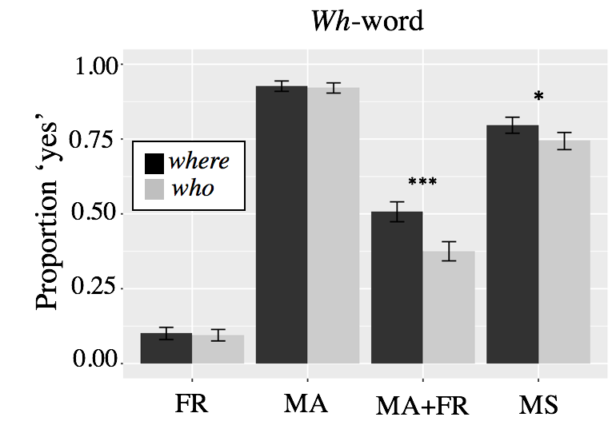
Who vs. where
Significant difference for MST
(X²(1) =6.61, p<.05)
And bigger for MATF (X²(1)=30.21, p<.0001)

Slide 135
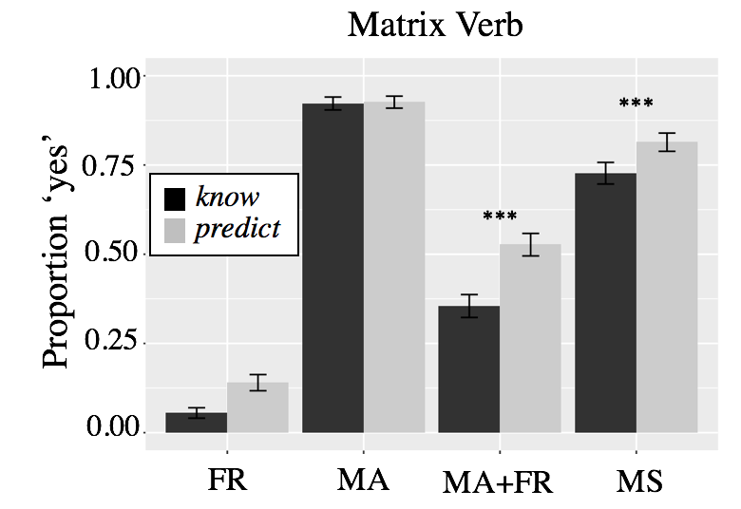
Know vs predict
Significant difference for MST
(X²(1)=18.89, p < 0.001)
And for MATF
(X²(1)=51.73, p<.0001)

Slide 136
Ex2: Low stakes, +FIN
Mark is visiting his cousins in New York City for the first time, and wants to take the best pictures possible to show his family back home. The Ultimate Guide to New York City 2018 gives the following ranking for places where tourists can snap great pictures of the city:
Location A was voted the best, and won 5/5 stars,
Location B won 4 stars,
Location C, 3,
Location D, 2,
Location E, 1, and
Location F was voted the worst, and so won no stars.
Mark ends up going to Locations A, B, C, D, and E. Afterwards, Mark's uncle asks the cousins, "Where did he go to see the city?"
Max Informative
“A,B,C,D,E”
“A” / “AB”
“D” / “DE”
Min Informative
Notes:
A low stakes context will change how informative an answer is, so a high ranked MS/MO is equally as informative as an MA

